Slide 1
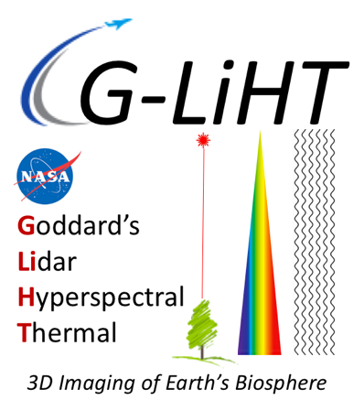
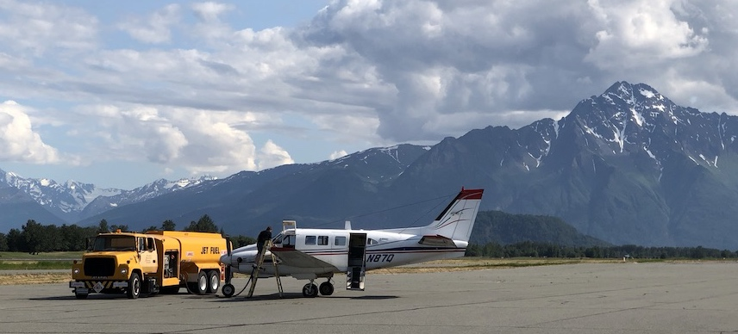
NASA-USFS Partnership to Advance Operational Forest Monitoring in Interior Alaska
Bruce Cook¹*, Hans Andersen², Doug Morton¹, Andy Finley³, Mike Alonzo⁴, Chad Babcock⁵, Sean Cahoon², Larry Corp⁶, Allison Nussbaum⁶
¹NASA Goddard Space Flight Center, ²USDA Forest Service, ³Michigan State Univ., ⁴American Univ., ⁵Univ. of Minnesota, ⁶Science Systems & Applications
NASA ABoVE Affiliated Project
funded by
NASA Carbon Monitoring System
NASA Terrestrial Ecology USFS PNW Research Station

Slide 2
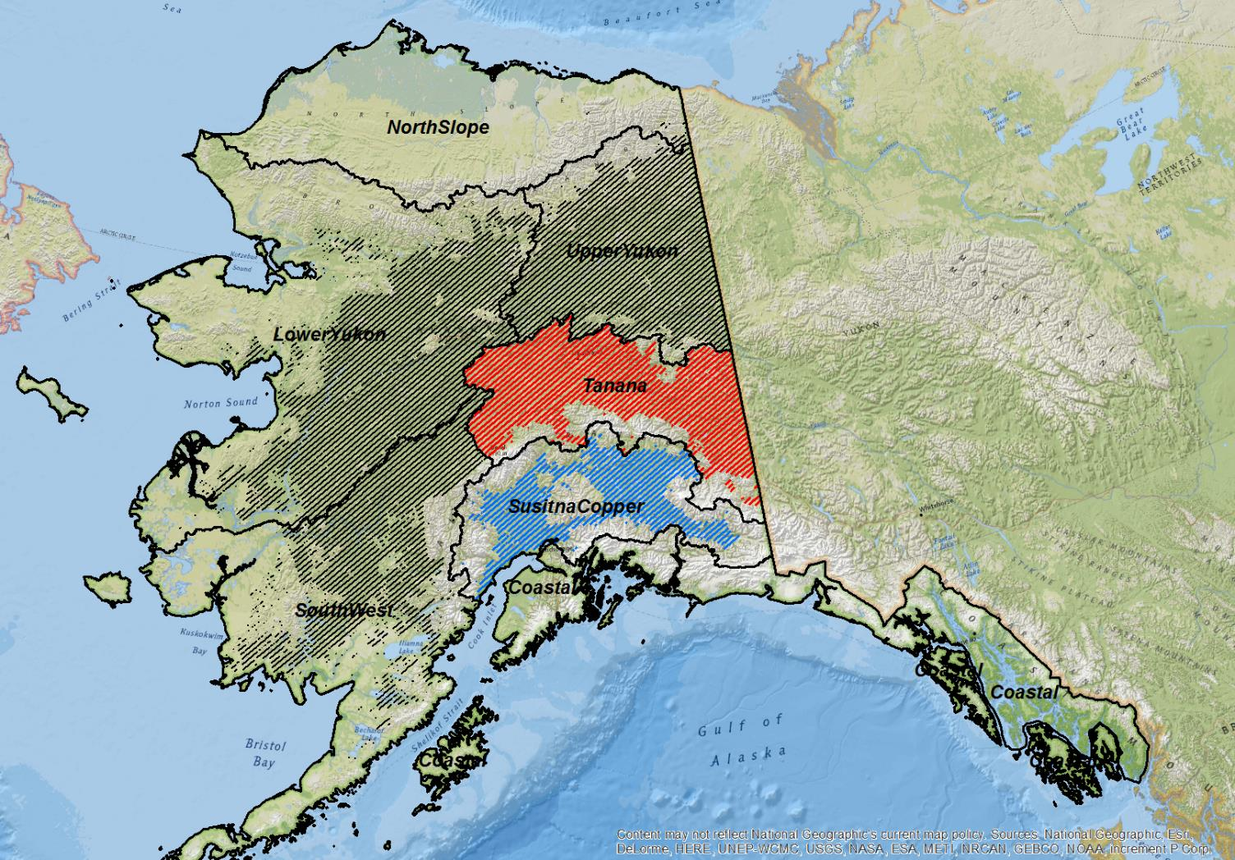
Joint NASA-USFS Inventory of Interior AK: The Most Remote US Forest Lands
Cook, B., H. –E. Andersen, D. Morton, A. Finley, M. Alonzo, C. Babcock, S. Cahoon, L. Corp, A. Nussbaum
Background
Forests of interior Alaska are the last “missing piece” of US inventory.
>450,000 km2 of forest land in interior Alaska (15% of US total) are not included in the USFS Forest Inventory & Analysis (FIA) program.
Analysis
Inventory plots cost $5-10k/plot to measure on the ground.
A hybrid approach using a sparse density of ground plots and NASA’s state-of-the-art airborne remote sensing is a cost-effective measurement option.
Findings
Computationally-efficient methods have been developed to produce statistically robust model-based (maps) and model-assisted (tables) of forest attributes and uncertainties.
Multi-Sensor airborne data has improved spatial estimates of forest and shrub biomass; losses due to fire; and impact of permafrost thaw.
Significance
This study will answer Mission Statements of both NASA and USFS :
How much forest land is there, and how is it changing in response to climate change, fire, drought, insects and disease?
Are forest resources sufficient to meet needs of local communities (species, size class, volume, productivity)?
Will ecosystems continue to support wildlife and local subsistence living?
Are these ecosystems (include live/dead trees, shrubs, and soils) a net carbon source or sink?
Flight lines that flown to acquire multi-sensor data with NASA Goddard’s Lidar, Hyperspectral and Thermal (G-LiHT) over US Forest Service Inventory plots (red, 2014; blue, 2018; black, 2019-27)

Slide 3
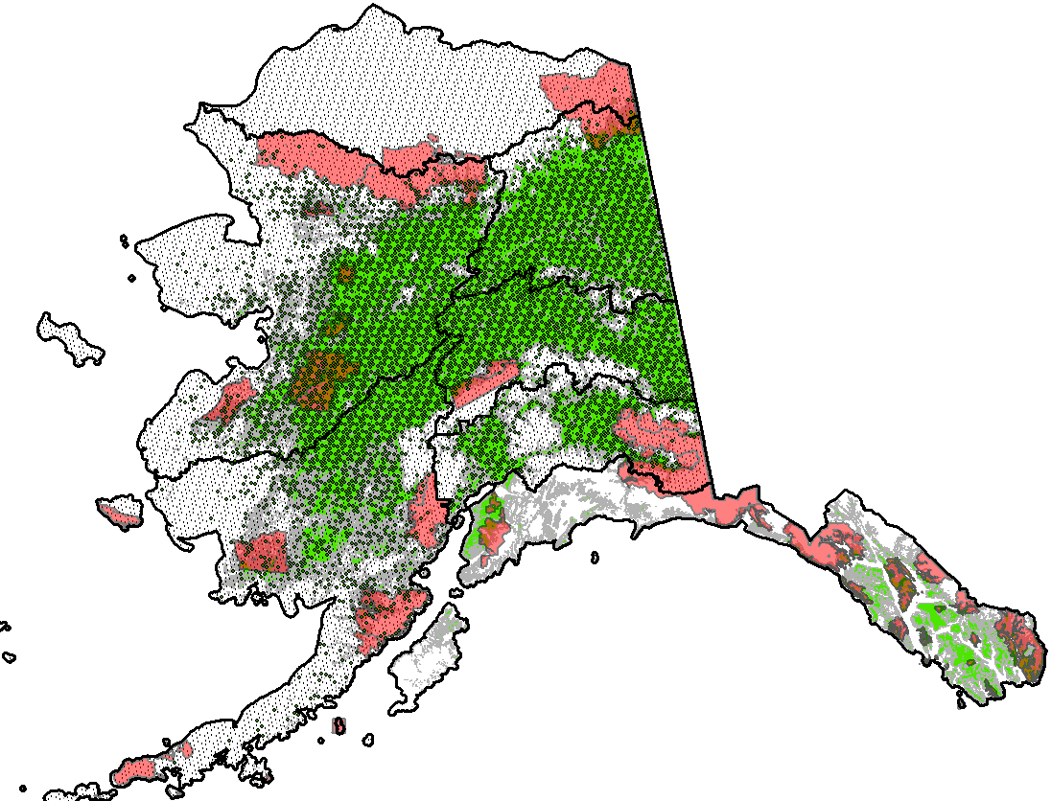
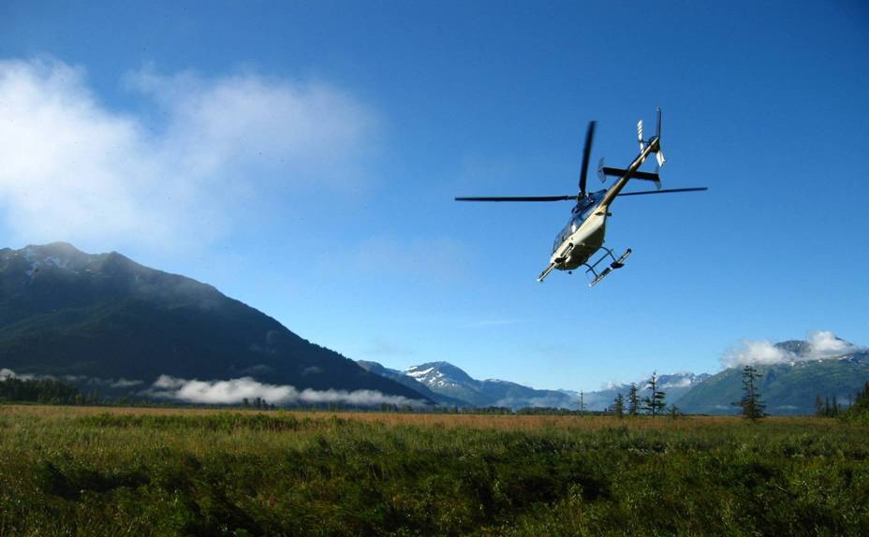
USFS FIA Ground Plot Sampling Design
Virtually all FIA plots in interior
Alaska are helicopter-access
Interior Alaska inventory units and FIA sampling grid in relation to forest cover and wilderness areas, where helicopter access to FIA plots is prohibited.
Total Forested Land Area = 48%
Heavily Forested Region
Downloadable databases for the 33.7 million acre Tanana Valley (2014-2018, n=800 plots, 100 preset queries) are now available online!
Marginally Forested
Designated Wilderness – no field survey
Forested Field Plot
All Field Plots
https://www.fs.usda.gov/pnw/tools/pnw-fia-interior-alaska-database

Slide 4
NASA G-LiHT Airborne Imaging Transects
Inventory Unit | Size (km²) | Reference | Years
Tanana (pilot) | 138,572 | Arkansas | 2014-2018
Susitna-Copper | 124,273 | Pennsylvania | 2018-2020
Southwest | 310,141 | New Mexico | 2020-2022
Lower Yukon | 410,078 | Montana | 2023-2026
Upper Yukon | 154,420 | Georgia | 2027-2029
G-LiHT Sampling transects are spaced 9 km apart to collect multi-sensor data over FIA plots and areas in-between, and both airborne and ground measurements will be used to produce the first comprehensive inventory of forests in interior Alaska in >40 years.
User-friendly L1-L3 data products are shared with the science community through G-LiHT’s map-based interface
https://glihtdata.gsfc.nasa.gov/
and will be mirrored by LP DAAC.

Slide 5
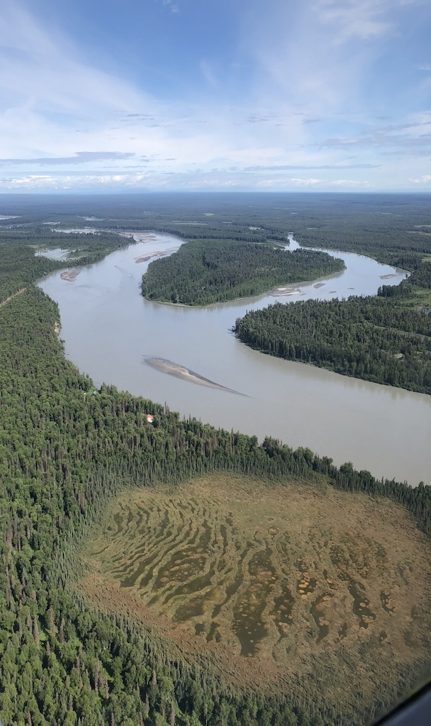
Goals and Regional Objectives
All inventory units of Interior Alaska
Pre-field imagery for ground crews (forest/non-forest; landing)
Pixel-level forest biomass predictions & uncertainties by species
Tanana Valley Inventory Unit & Kenai Peninsula
Quantify the effects of fire disturbance and recovery
Detect and quantify effects of thawing permafrost
Susitna-Copper River Inventory Unit
Quantify shrub and forest biomass (by species, live/dead)
Detect extent of forest health and insect/disease outbreaks
Southwest Inventory Unit
Quantify the spatial distribution of soil organic carbon
Optimize sampling to target regions with highest uncertainty

Slide 6
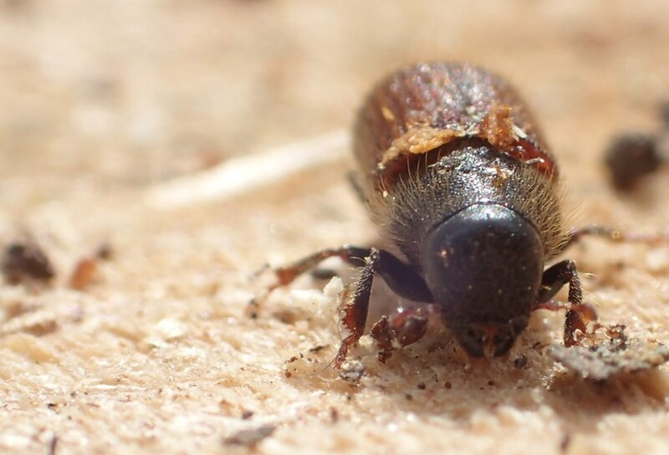
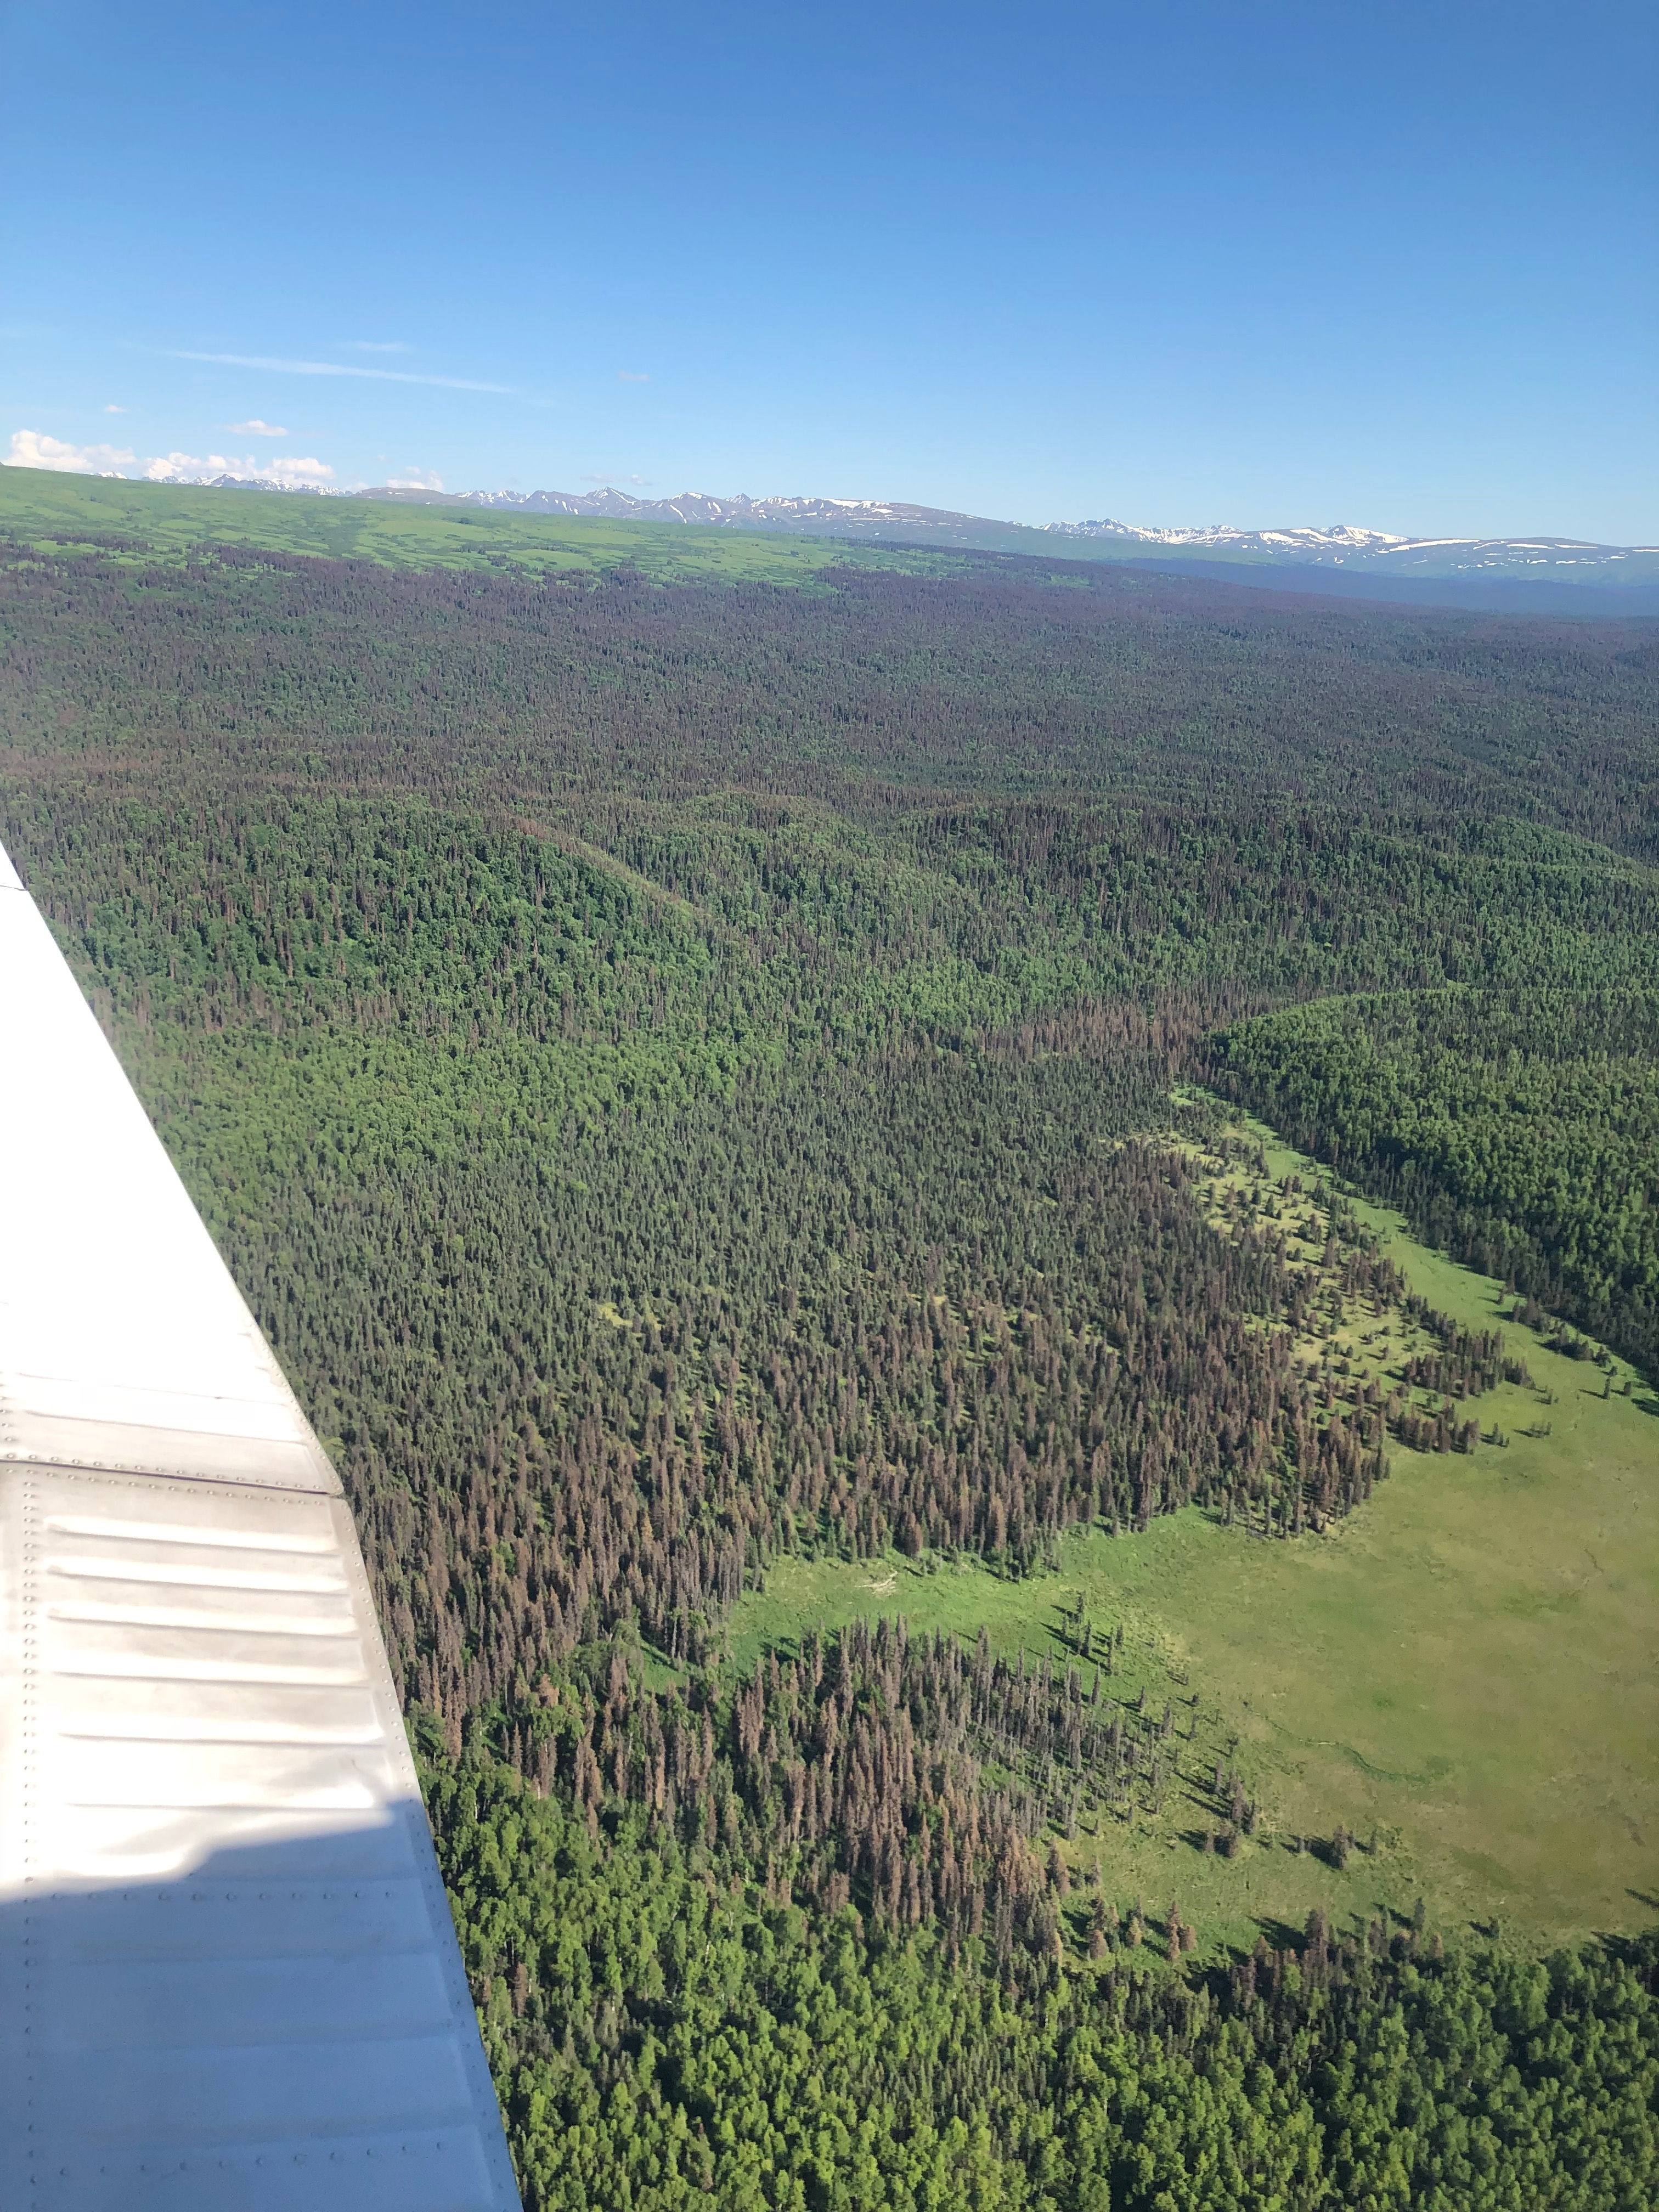
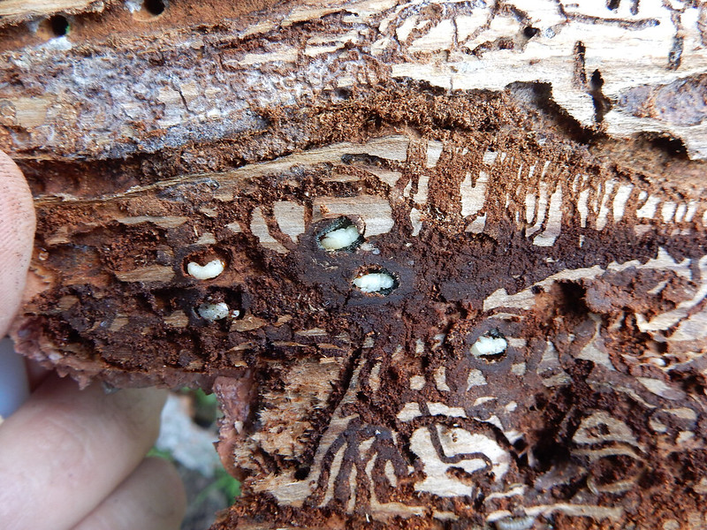
2018 Spruce Beetle Outbreak in AK

Slide 7
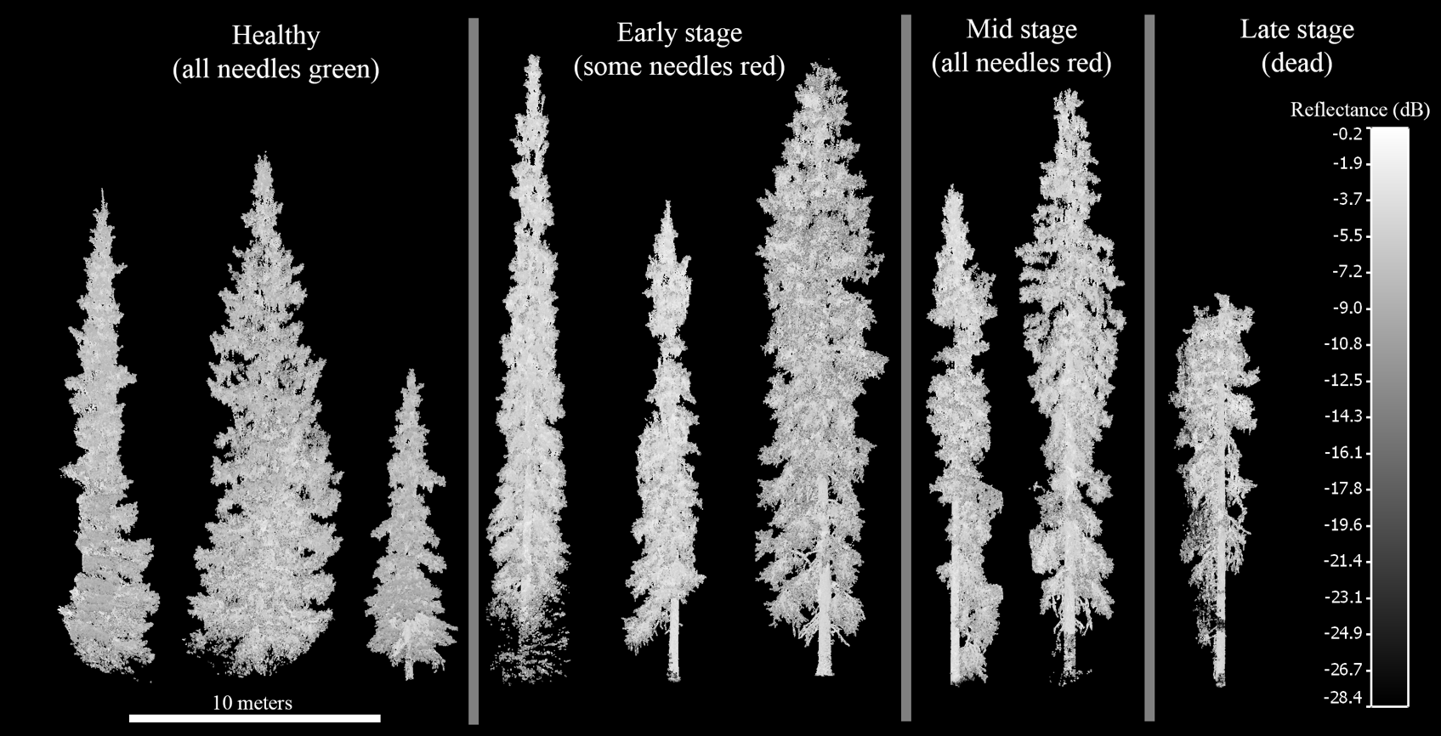
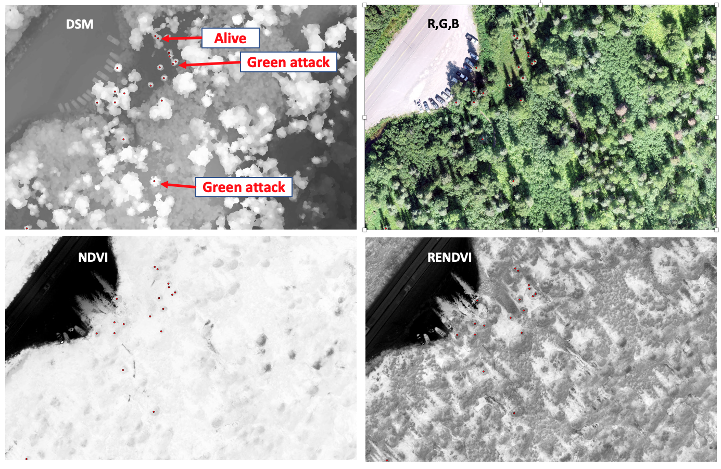
Hyperspectral Remote Sensing Stages of Infestation
Paynter et al.
Changes in tree architecture measured with terrestrial laser scanning (TLS; above), and canopy structure and and spectral indicators obtained from G-LiHT and UAS platforms (right).
Cessna, J., M. G. Alonzo, A. C. Foster, and B. D. Cook. 2021. Mapping boreal forest spruce beetle health status at the individual crown scale using fused spectral and structural data. Forests 12:1145, http://doi.org/10.3390/f12091145.

Slide 8
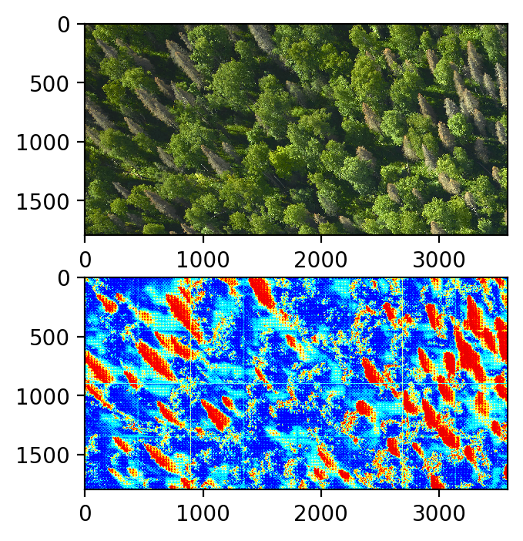
Fine-Resolution (3 cm) RGB Stereo Imagery for Live/Dead Classification
Aytac et al.
Location of live and dead trees during 2018 spruce bark beetle outbreak in interior Alaska using G-LiHT fine-resolution RGB orthomosaics
U-Nets neural network architecture
(Ronneberger et al., 2015)

Slide 9
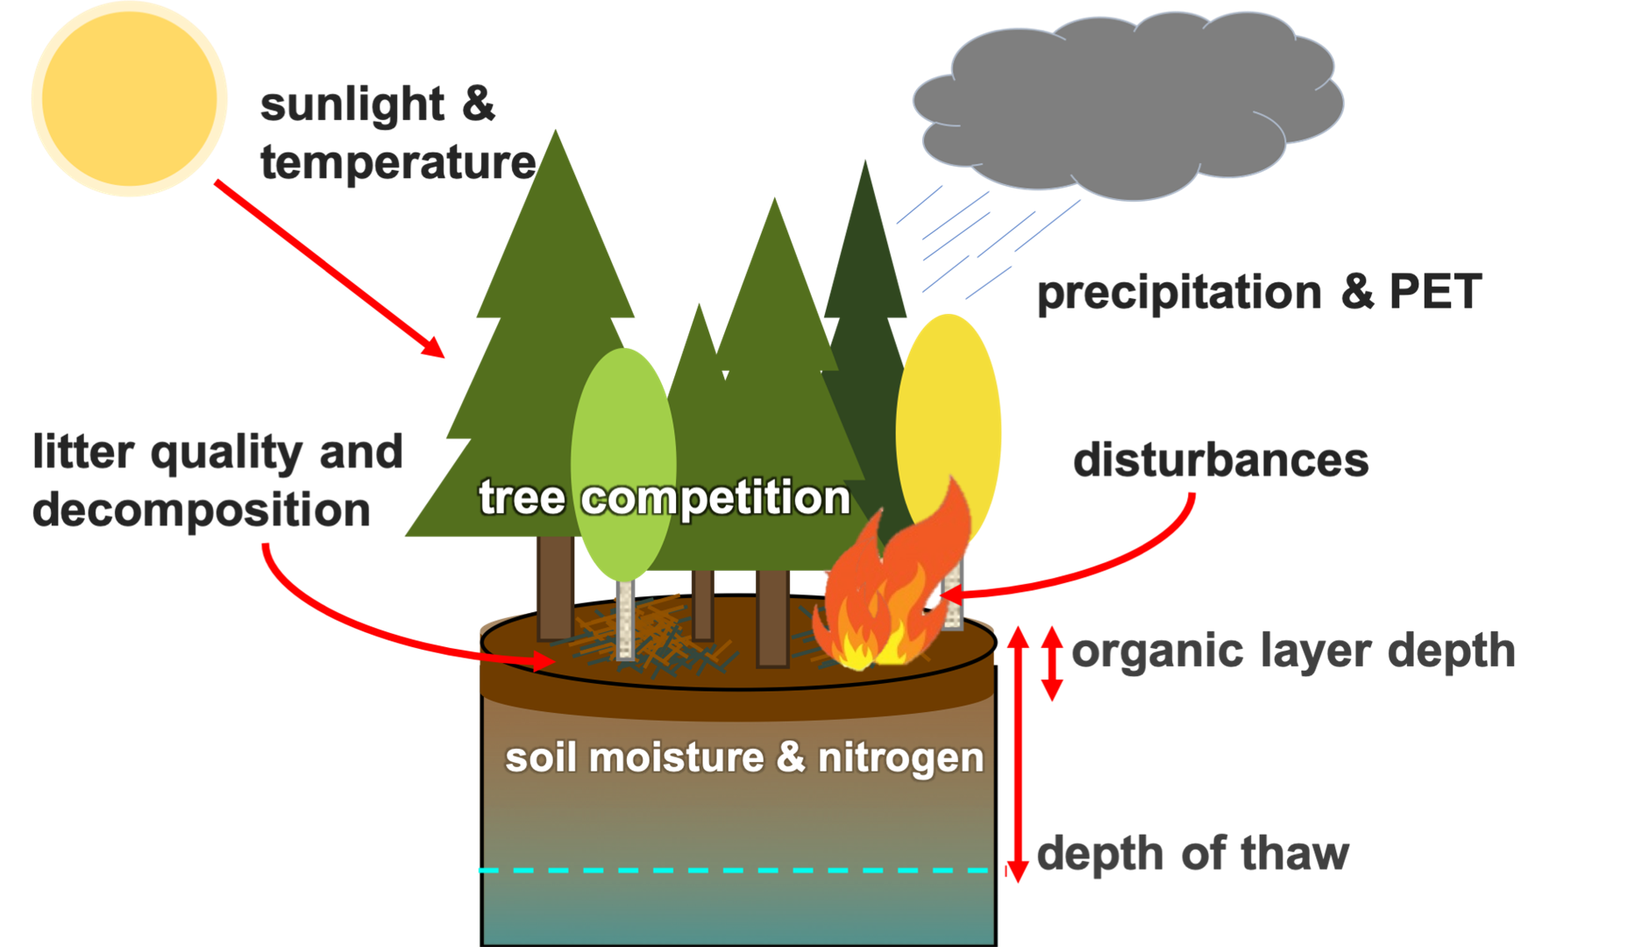
Modeling future insect outbreaks and tree-scale disturbances
Palace et al., RSE, 2015
Voxel representation of
G-LiHT LiDAR point clouds
from Bonanza Creek, AK
Initialization & Calibration
Lidar-derived canopy height and vertical structural metrics at Bonanza Creek, AK
Dave Lutz, NASA ABoVE project
Notes:
Palace M, FB Sullivan, MJ Ducey, C Czarnecki, J Zanin Shimbo, Jonas Mota e Silva (2015). Estimating forest structure in a tropical forest using field measurements, a synthetic model and discrete return lidar data. Remote Sensing of Environment, 161, 1-11. doi:10.1016/j.rse.2015.01.020.

Slide 10
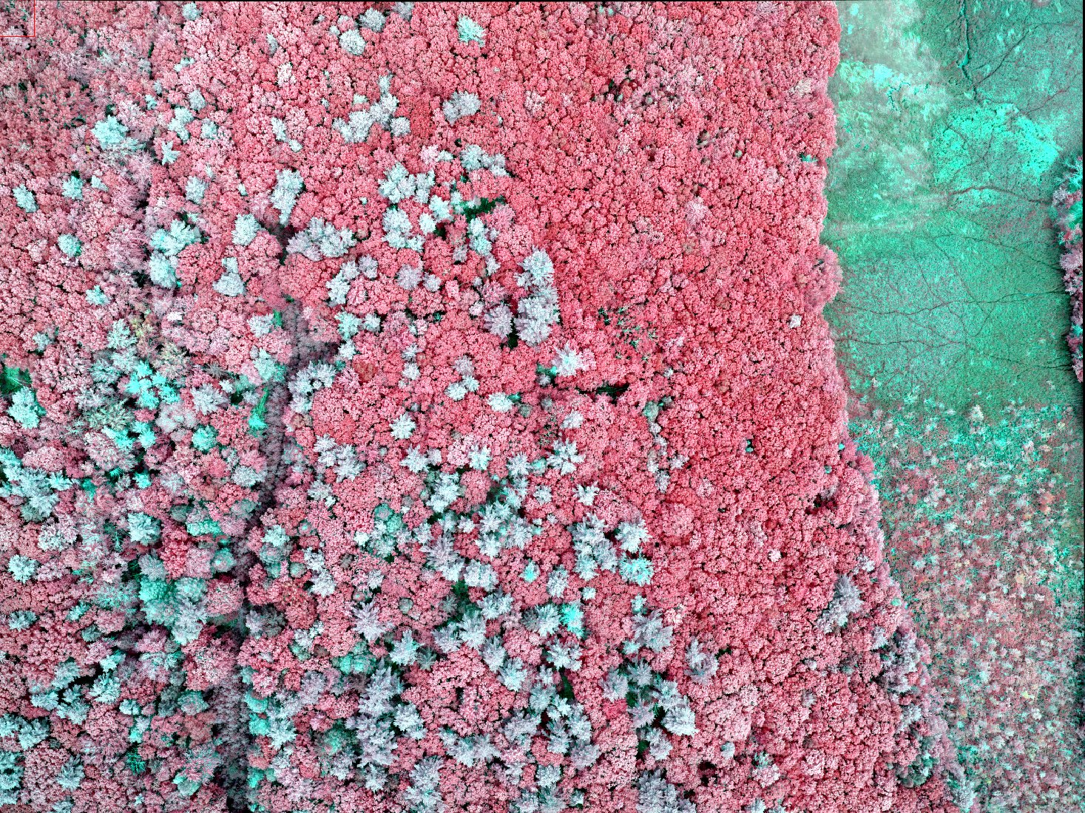
G-LiHT RGB-NIR Stereo Imager -- in 2021
Tightly co-registered RGB-NIR enables quantification of:
Dieback
Photosynthetic vs. non-photosynthetic material
Coarse woody debris
Hyperspatial host-species classification
Stress
Canopy volume by forest type (with coincident lidar data)
CIR – Holt Research Forest, ME, 2021

