Slide 1
G-LiHT 2022 Flight Campaign Operational Readiness Review (ORR)
Bruce Cook, GSFC
Biospheric Sciences Laboratory, Code 618
Date/Time: 16 June 2022, 1 pm EDT

Slide 2
ORR Participants
Review Panel:
TBD – Wallops Flight Facility (WFF), VA
G-LiHT Team:
Bruce Cook – GSFC, Code 618, G-LiHT PI/instrument operator
Larry Corp – GSFC/Sigma Space, Code 618, G-LiHT instrument scientist/operator
Allison Nussbaum – GSFC/Sigma Space, Code 618, G-LiHT instrument scientist/operator
Jesse Barber – GSFC/Sigma Space, Code 618, Backup G-LiHT instrument operator
CAS Airborne Data Acquisition (ADA; Dynamic Aviation, Bridgewater, VA):
Ethan Pearce – Manager, ADA Flight Operations
Matt Donald – ADA Flight Operations Manager
Primary POC:
Bruce Cook
Code 618, Biospheric Sciences Branch
NASA – Goddard Space Flight Center
Greenbelt, Maryland 20771
301.614.6689 (office), 301.312.7692 (cell)
301.614.6695 (fax)
bruce.cook@nasa.gov
brucecook@umn.edu

Slide 3
NASA WFF Operational Readiness Review (ORR)
A 5-7 member NASA-convened panel that reviews the operational requirements for a specific flight or campaign. ORR’s are conducted for single aircraft conducting a mission.
The following items shall be presented for review:
Science mission requirements
Science payload and operations
Flight operations procedures
Operational Go/No-Go criteria
Pilot qualifications, medicals, flight operations training, and flight manuals
Aircraft configuration
Aircraft maintenance
Payload combination
Status of reviews and required documents
Special weather conditions
Instrument check flight plan
Logistics plan
Mishap Preparedness Contingency Plan (MPCP)

Slide 4
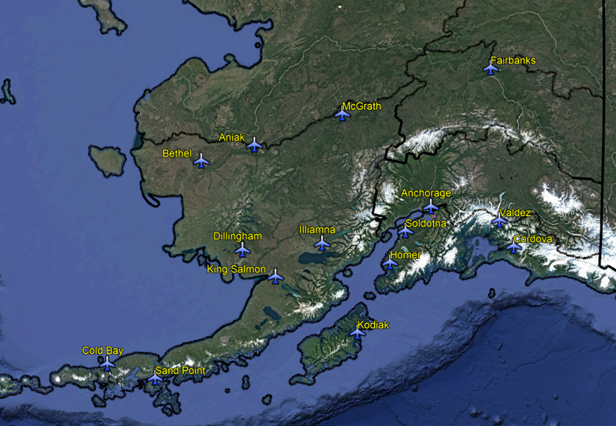
1) Science Mission Requirements
During 2022, G-LiHT will conduct a ~5 week airborne campaign focusing on science data acquisitions in Alaska, beginning the week of 27 June 2022. This will include:
Integration and instrument check flight of G-LiHT near Bridgewater, VA (1 d integration, 1 d flight);
Transit of aircraft and G-LiHT from Bridgewater, VA, to Kodiak, AK (2-5 d);
G-LiHT science flights in Interior and Coastal AK (~3 week); and
Transit of aircraft and G-LiHT from Kodiak, AK, to Bridgewater, VA, and de-integration (2-5 d; 1 d).
OVERNIGHT BASES
Bridgewater, VA (KVBW)
Kodiak, AK (PADQ)
Aniak, AK (PANI)
Anchorage, AK (PANC)
Fairbanks, AK (PAFA)
FUEL
Southwest Interior AK
McGrath, AK (PAMC)
Bethel, AK (PABE)
Dillingham, AK (PADL)
Illamna, AK (PAIL)
Coastal AK
Cordova, AK (PACV)
Valdez (PAVD)
Kenai Peninsula
Kenai, AK (PAEN)
Soldotna, AK (PASX)
Homer (PAHO)
AK Peninsula
Cold Bay, AK (PACD)
Sand Point, AK (PASD)

Slide 5
1) G-LiHT Instrument Check Flight
Investigator(s):
Bruce Cook, NASA GSFC (PI)
Funding Sources:
G-LiHT Work Package and NASA Terrestrial Ecology Program
USFS Pacific NW Research Station
Motivation:
An instrument check flight is required to verify instrument performance and boresight instruments with the GPS-INS. The flight has been conducted successfully over a sight in Harrisonburg, VA, since 2017, where buildings and pitched roofs serve as reference targets.
Science Requirement:
To acquire G-LiHT airborne image data (lidar, hyperspectral, thermal, stereo aerial photographs) over a G-LiHT boresight alignment site in Harrisonburg, VA (ideally under clear skies, ± 3 h from solar noon).
Success Criteria:
Acquire data from 100% of all flight lines.

Slide 6
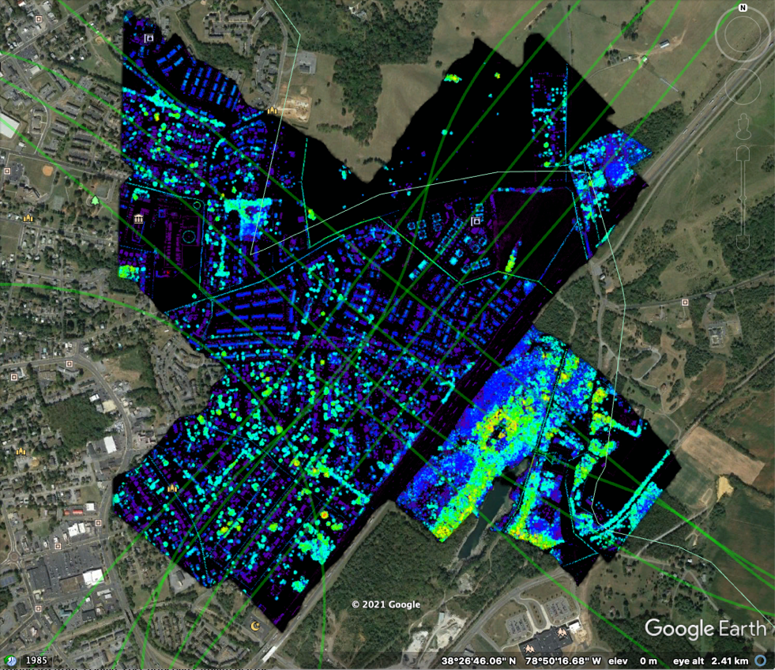
Harrisonburg Boresight Alignment Site
Four sets of perpendicular flight lines (lime green) over houses with pitched roofs for lidar boresight alignment.
Adjacent lines are flown in opposing directions with ~50% overlap.
E.g., Canopy Height Model (CHM)
Harrisonburg, VA, 2018

Slide 7
2) Interior Alaska
Investigator(s):
Bruce Cook, NASA GSFC (PI)
Hans-Erik Andersen, USFS PNW Experiment Station (Co-I)
Miho Welton, Statewide Inventory Forester, State of AK, Division of Forestry (Co-I)
Funding Sources:
G-LiHT Work Package and NASA Terrestrial Ecology Program
USFS Pacific NW Research Station
Motivation:
USFS Southwest Inventory Unit. Forests of interior Alaska are the last "missing piece" of US inventory, and this joint NASA-USFS project addresses key mission goals of both agencies, including "How much forest land is there, and how is it changing in response to climate change, fire, drought, insects and disease?" A ground plot-based Inventory is cost prohibitive in Interior Alaska due to the remoteness and size of the region, so a hybrid approach was developed by NASA-USFS using a sparse density of ground plots and NASA's state-of-the-art airborne remote sensing as a cost-effective measurement option. Multi-sensor airborne data will be collected with NASA Goddard's Lidar, Hyperspectral and Thermal (G-LiHT) airborne imager over Forest Inventory and Analysis (FIA) plots and transects between FIA plots in Alaska to improve regional estimates of aboveground forest biomass and terrestrial ecosystem carbon stocks.
Carbon Cap-and-Trade Pilot Study (near Fairbanks, AK). The California Air Resources Board (CARB) cap-and-trade program is one of the major carbon offset markets in the US and provides forest landowners with an alternative source of revenue by keeping trees on the land and reducing carbon emissions. Currently, the boreal forests of interior Alaska, which represent an estimated 115 million acres of forestland, are not included in their protocol due to a lack of historical Forest Inventory and Analysis (FIA) data which is used to set the common practice values (CARB, 2015). The objectives of the pilot project are to assess the feasibility of using repeat-pass G-LiHT measurements to estimate aboveground carbon stocks with sampling error below the 20% threshold and to develop the most cost-effective carbon inventory protocol using a combination of field inventory data and advanced, multi-sensor airborne remote sensing. The data collected during the pilot project also helps develop historical carbon stock data to set the common practice values which are used as the baseline in forest growth-and-yield (100-yr) projections and verified by repeated forest inventory.
Permafrost Monitoring (near Fairbanks, AK). G-LiHT image data will be re-acquired over long-term permafrost monitoring sites in the Fairbanks area. These sites are measured periodically by ground crews and were measured in 2014 and 2018 with G-LiHT.
FIA Plot Cal/Val (near Anchorage, AK). G-LiHT image data will be acquired over USFS FIA training plots where field crews will be collecting traditional measurements and Terrestrial Laser Scanning (TLS) data during August 2022.
Spruce Beetle Monitoring (near Anchorage, AK). G-LiHT image data will be re-acquired over spruce beetle monitoring transects stretching from the Kenai Peninsula, in the south, to Denali National Park, in the north. These transects were last measured on the ground and with G-LiHT during 2018, during the peak of a spruce beetle outbreak, and changes in vegetation structure and spectral reflectance will be used to evaluate the long-term mortality and growth of these forests.
Science Requirement:
To acquire G-LiHT airborne image data (lidar, hyperspectral, thermal, stereo aerial photographs) over Interior AK targets of interest, ideally under clear skies, ± 3 h from solar noon.
Success Criteria:
Acquire data from 80% of all flight lines.

Slide 8
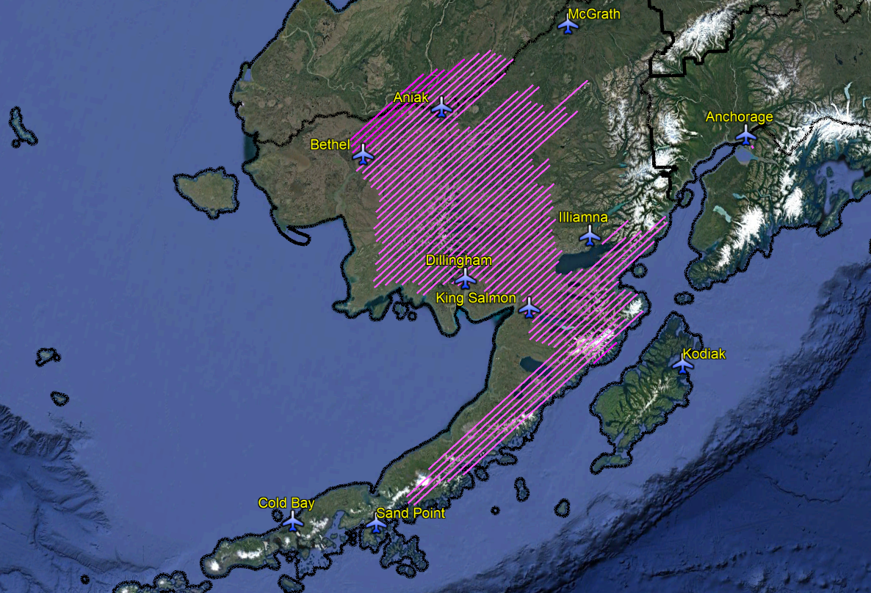
USFS Southwest Inventory Unit
Denali
Talkeetna
AK Range
Chugach
Kuskokwim Mtns.
Kenai
Katmai
Alaska Peninsula
Single-pass flight lines over USFS ground plots and area between plots.
Swath width is ~250 m at 335 m AGL, and distance between parallel transects is ~ 9 km.

Slide 9
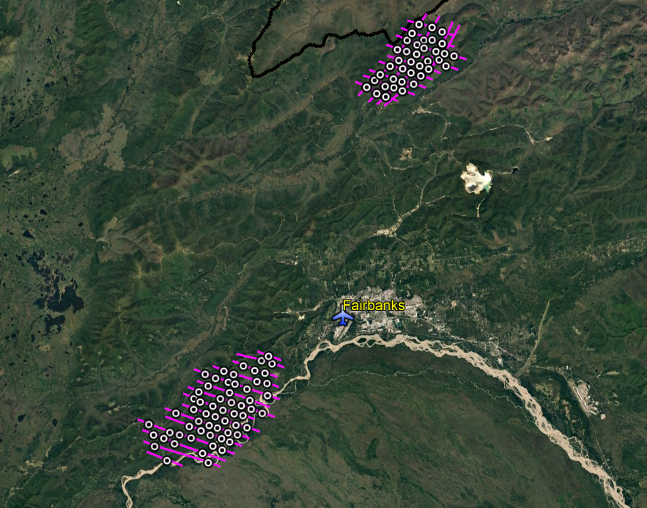
Fairbanks Area
Locations:
Bonanza Creek Experimental Forest
State of AK and USFS
Caribou-Poker Creeks Research Watershed, State of AK and UAF
Creamer’s Field (2 transects)
AK Dept. of Fish & Game
Permafrost Tunnel
US Army Corp of Engineers
Tanana Flats
Fort Wainwright, US Dept. of Defense
Caribou-Poker Creeks
Creamer’s Field
Permafrost Tunnel
Tanana Flats
Bonanza Creek
Acquistions:
Single-pass flight lines over USFS ground plots and area between plots.
Swath width is ~250 m at 335 m AGL.

Slide 10
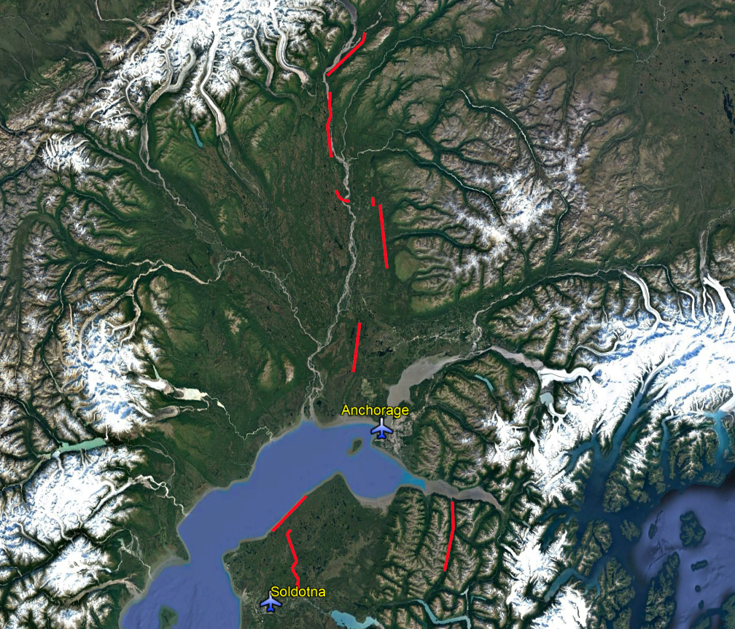
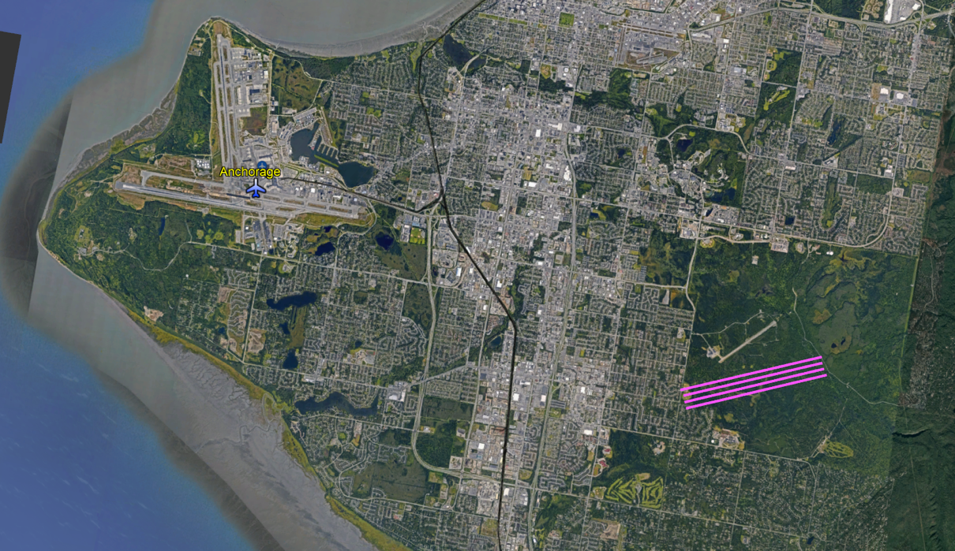
Anchorage Area
Spruce beetle transects
Campbell plots
Locations:
FIA training plots near Campbell Airport (KCSR)
BLM Anchorage Field Office/Airport
Transects following spruce beetle outbreak
Kenai Peninsula (S) to Denali National Park (N)
Acquistions:
Single-pass flight lines over USFS ground plots and area between plots.
Swath width is ~250 m at 335 m AGL.

Slide 11
3) Coastal Alaska
Investigator(s):
Bruce Cook, NASA GSFC (PI)
Hans-Erik Andersen, USFS PNW Experiment Station (Co-I)
Nathan Pugh, USFS Geospatial Technology and Applications Center (GTAC)
Funding Sources:
G-LiHT Work Package and NASA Terrestrial Ecology Program
USFS Geospatial Technology and Applications Center (GTAC)
Motivation:
USFS Geospatial Technology and Applications Center will use G-LiHT data acquired over FIA and GTAC measured ground plots and area between plots to map forest characteristics on federally managed lands, including forest type, biomass, vegetation structure, tree and shrub cover, etc. Data will also be used to guide future inventory efforts in Coastal AK using methods developed for Interior AK.
Science Requirement:
To acquire repeat coverage of G-LiHT airborne image data (lidar, hyperspectral, thermal, stereo aerial photographs) over Coastal AK targets of interest, ideally under clear skies, ± 3 h from solar noon.
Success Criteria:
Acquire data from 80% of all flight lines.

Slide 12
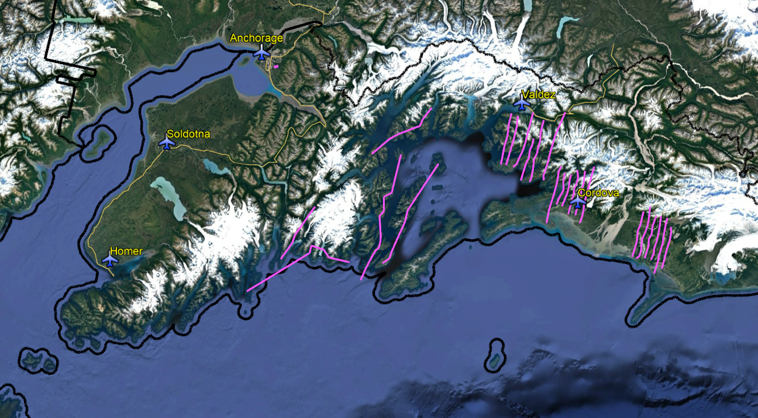
Chugach National Forest
Prince
William
Sound
Cook
Inlet
Copper
River
Delta
Single-pass flight lines over USFS ground plots and area between plots.
Swath width is ~250 m at 335 m AGL.

Slide 13
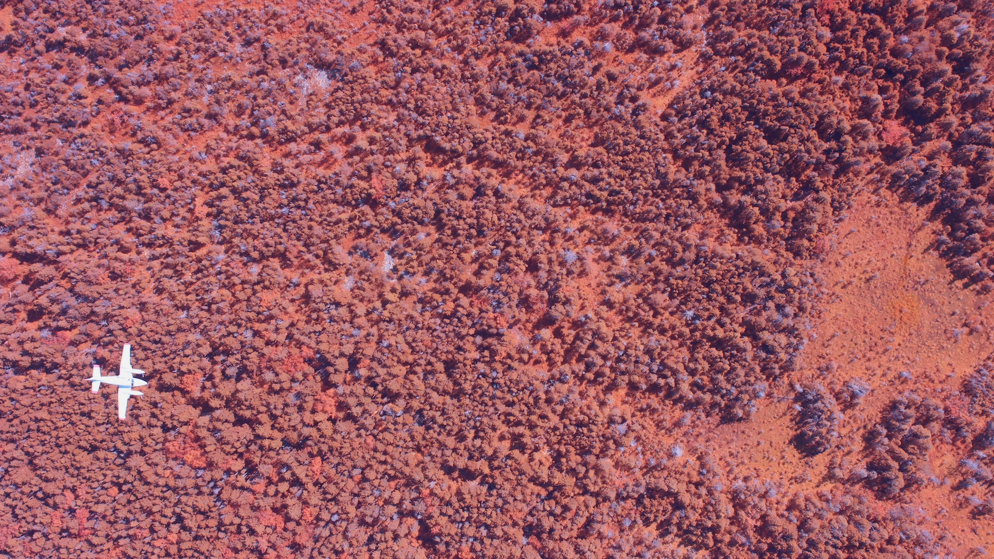
2) G-LiHT Science Payload
G-LiHT on Dynamic Aviation N87Q
Schoodic Peninsula, ME
16 August 2017

Slide 14
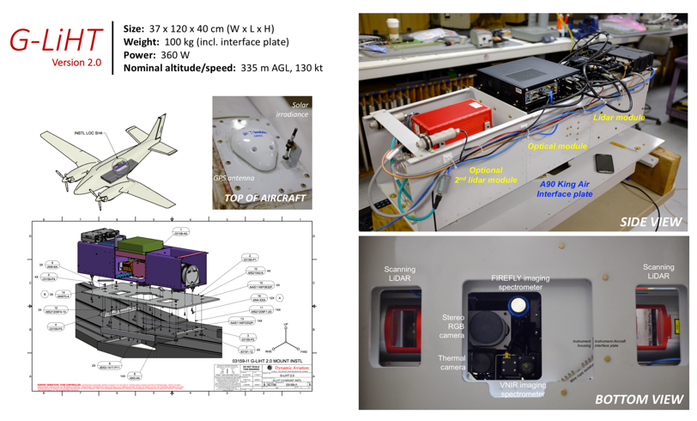
NASA Goddard’s Lidar, Hyperspectral & Thermal (G-LiHT) Airborne Imager
Background
G-LiHT is a portable, multi-sensor airborne imaging system that simultaneously maps the composition, structure, and function of terrestrial ecosystems using:
lidar to provide 3D information about canopy structure;
VNIR and SWIR Imaging spectroscopy to discern species composition and variations in biophysical variables (e.g., photosynthetic pigments);
thermal measurements to delineate wetlands and detect heat stress; and
stereo RGB photographs to identify fine-scale (~3 cm) canopy features.
Analysis
G-LiHT provides co-registered, fine-scale observations (0.03 to 1 m) and data products covering large areas and environmental gradients to understand tree-scale ecosystem interactions with atmosphere, hydrosphere and climate.
Next Generation G-LiHT v2.0
Results and Significance
Regional forest carbon stocks in CONUS & Mexico (NASA CCS; ICESat)
Inventory of forest carbon stocks & ecosystem dynamics in interior Alaska (USFS FIA; NASA CMS, ABoVE)
Earlier detection of forest insect & disease outbreaks (USFS FHP & FHM; NASA FLARE)
Nutrient & land-use interactions in tropical forests (US-DOE NGEE-Tropics)
Coastal ecosystem dynamics and biogeochemistry (NASA NIP, NASA-USDA CCS)
Post-hurricane damage and recovery assessments in Puerto Rico and South FL (NASA TE, USDA NIFA, DOI, FEMA)
Cross-calibration of NASA Earth Observing Satellites (NASA-USGS; Landsat, EOS)
Modeling of LiDAR and Solar-Induced Fluorescence (SIF) signals from space (NASA FLARE; ICESat-2, ESA FLEX, CESBIO)

Slide 15
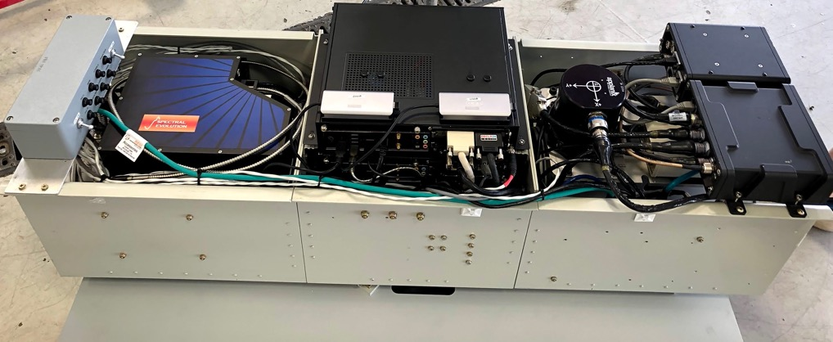
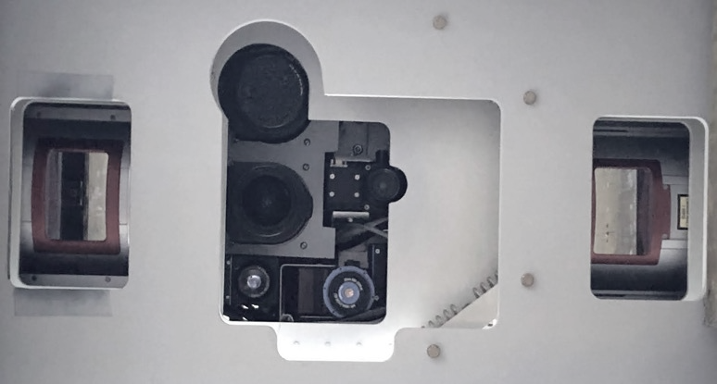
Goddard’s Lidar, Hyperspectral & Thermal airborne imager
Breakers
Lidar & Irradiance
Spectrometer
Computers &
Passive Imagers
LiDAR &
GPS-INS
SIDE VIEW
A90 King Air interface plate
Scanning
LiDAR
Scanning
LiDAR
Stereo
NIR+RGB
VNIR
spectrometer
Thermal
camera
SWIR
spectrometer
BOTTOM VIEW

Slide 16
G-LiHT Design and Flight Heritage (Cont’d)
G-LiHT Instrument package was originally designed, fabricated and tested in partnership with NASA Langley Research Center (2011), and upgraded in partnership with Dynamic Aviation (2017-present).
G-LiHT lidars use non-visible, Class 1 lasers according to IEC60825-1:2007, and do not require a GSFC 23-6L or FAA form 7140 since the maximum permissible exposure (MPE) cannot be exceeded when viewing with the naked eye or with the aid of typical magnifying optics (e.g. telescope or binoculars).
~1500 science flight hours during 2011-19 on different NASA/CAS platforms without incident:
Cessna 206 (NASA LaRC; wing pod)
Piper Cherokee (Infrared Baron; interior camera port)
King Air UC-12B (NASA LaRC; interior camera port)
Cessna 206 (USDA FS; interior camera port)
King Air A90 (Dynamic Aviation N87Q and N80Y ; interior camera port)

Slide 17
G-LiHT Design and Flight Heritage (Cont’d)
Previous campaigns NASA has approved:
GSFC IRAD Instrument Demonstration and NASA Carbon Monitoring System (2011; MD, VA, NC)
NASA AMIGA-Carb (2011-2013; CONUS, Mexico)
NASA Carbon Monitoring System (2012; MD, MA, ME, WI)
Joint NASA-ESA Solar-Induced Fluorescence (2013; VA, NC)
Landsat 7/8 under flight (2013; OR, CA, NV, AZ)
Joint NASA-USFS Forest Health Protection surveys (2014-2019; NH, MA, ME, NY, RI, NM, OR)
Joint NASA-USFS Forest Inventory of Interior Alaska (2014, 2018, 2019; AK)
Joint NASA-Johns Hopkins APL fluorescence (2014-2015; VA)
Landsat 7/8 under flight and PIC site characterization (2015; CA)
Univ. of TN-Knoxville clandestine grave sites (2015-2016; TN, TX)
NASA NIP, Carbon Cycle and Rapid Response flights in FL Everglades (2015, 2017; FL)
Tropical forest and coastal ecosystem biomass estimation (2015; Bahamas)
US-DOE NGEE-Tropics (2017; Puerto Rico)
University of Maine forest disturbance and regrowth (2017, 2021; ME)
FLARE: NASA’s Fluorescence Airborne Research Experiment (2017-18; Puerto Rico, VA, MD, AK)
Post-Hurricane damage assessment (2017-18, 2020; FL, Puerto Rico)
Joint NASA-USFS forest fire combustion and emissions (2019, CA)
NASA Surface Topography and Vegetation (2021; Mid-Atlantic US)

Slide 18
3) Flight Operation Procedures
Visual Flight Rules (VFR)
Data acquisition parameters:
Nominal flying altitude of 1100 feet AGL (±200 feet)
Nominal air speed of 130 knots (±20)
Aircraft range:
800 nautical miles at 160 knots (5 hours with 45 min fuel reserve)
shorter flights may be required to prevent fatigue
Navigation:
Flight lines are created with Track’AiR X-TRACK Flight Management Software and GIS software (e.g., ArcMap, QGIS, Google Earth), and uploaded to the G-LiHT’s system and the pilot’s GPS (Garmin 696)
Pilot maintains course and has access to avionic databases with Garmin 696
Instrument operator can confirm location and provide near-real time AGL heights with streaming data from G-LiHT

Slide 19
Flight Operation Procedures (Cont’d)
Safety:
Flight plans are reviewed in advance for hazards and restricted airspace
Aircraft is equipped with radar altimeter and FAA-approved TCAS and TAWS systems
Aircraft receives in-flight ADS-B (Automatic Dependent Surveillance Broadcast), terrain awareness, traffic, FAA temporary flight restrictions (TFR) and weather information

Slide 20
4) Operational Go/No-Go Criteria
Weather and sky conditions:
daylight hours, ideally cloud-free skies
will not collect data during precipitation events
Pre-Flight Planning:
Fuel requirement
Airspace restrictions
Obstructions and terrain hazards
Mechanical condition of aircraft and communication systems
Crew health
G-LiHT Instrument performance on start-up

Slide 21
5) Pilot Qualifications
Crew: 2 pilots (1 captain, 1 first officer/A&P mechanic)
Required pilot’s license: Commercial Multiengine Land with Instrument Rating
Training and Currency: Pilots are required to complete a flight review and instrument proficiency check every 12 calendar months
Medical: 1st Class
Dynamic Aviation Policies:
Day operations (0500L – 1200L start time): 14 h of duty, 10 h of flight time
Night Operations (1201L – 0459L start time): 12 h of duty, 8 h of flight time
No more than 120 flight hours in 30 d
Crews are required to have 10 h of rest prior to any duty period
After 7 consecutive days of duty, crews shall have a minimum rest period, free from duty, of 32 consecutive hours before duty resumes

Slide 22
Aircraft
6) Configuration:
A90 King Air with FAA approved camera port
Aircraft is owned and maintained for commercial use by Dynamic Aviation (Bridgeport, VA)
Dynamic Aviation holds a Basic 135 Operator Certification and have flown previous campaigns with G-LiHT and other NASA remote sensing assets
NASA completed a CAS Site Inspection of Dynamic Aviation during 2021 by JSC, which is valid for 3 years.
7) Maintenance:
Registration and maintenance history documents have been provided to the review board

Slide 23
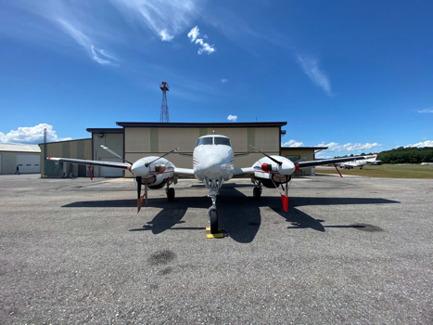
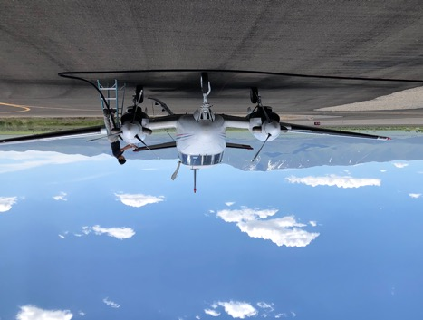
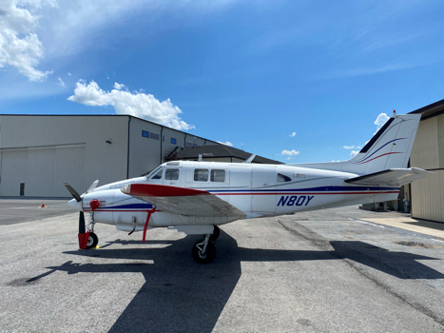
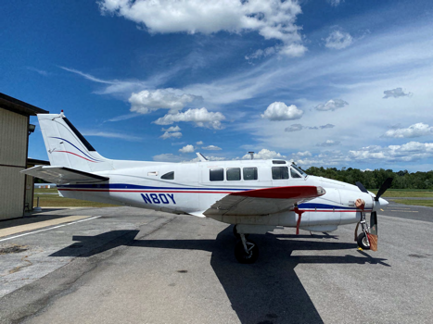
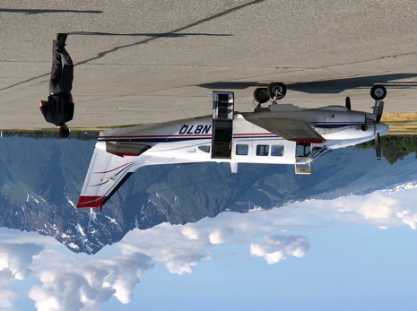
Dynamic Aviation A90 King Air
N80Y (2021)
N87Q (2017-19)

Slide 24
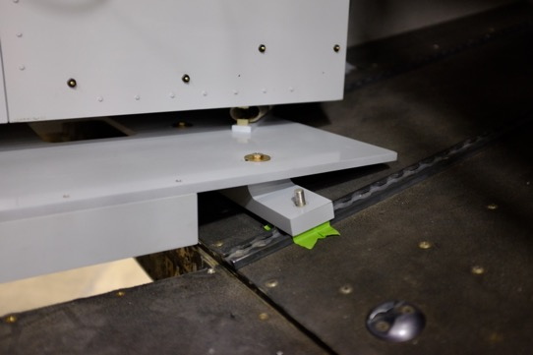
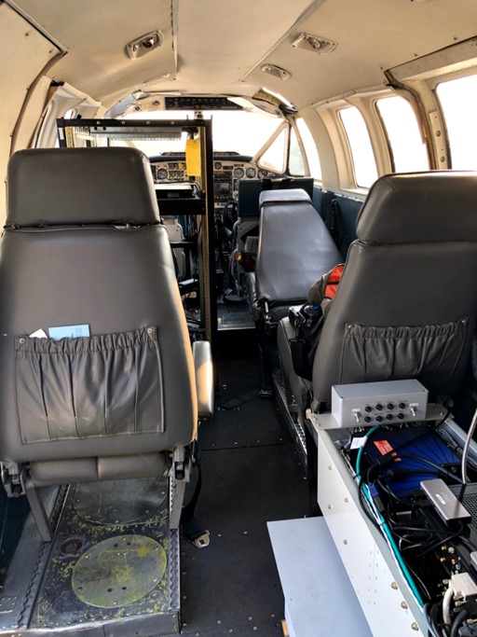
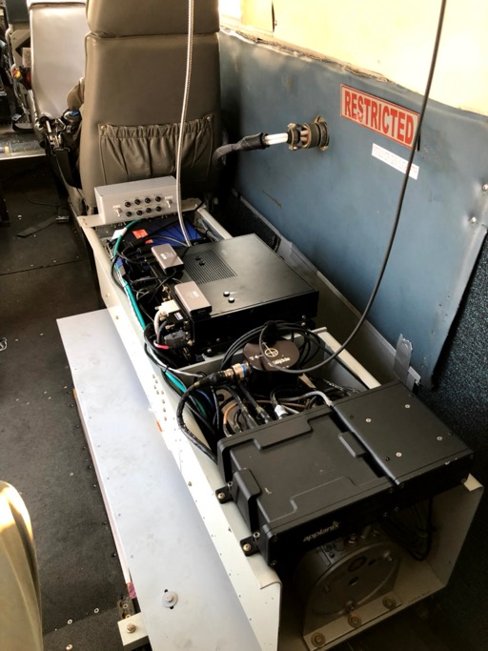
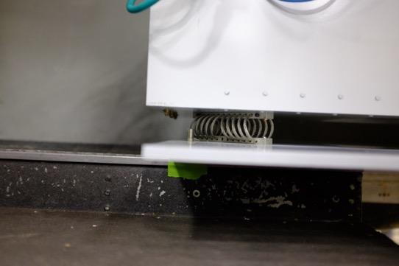
G-LiHT: Aircraft Installation on A90
Note: 8110 and stress analysis submitted to WFF with other aircraft documentation

Slide 25
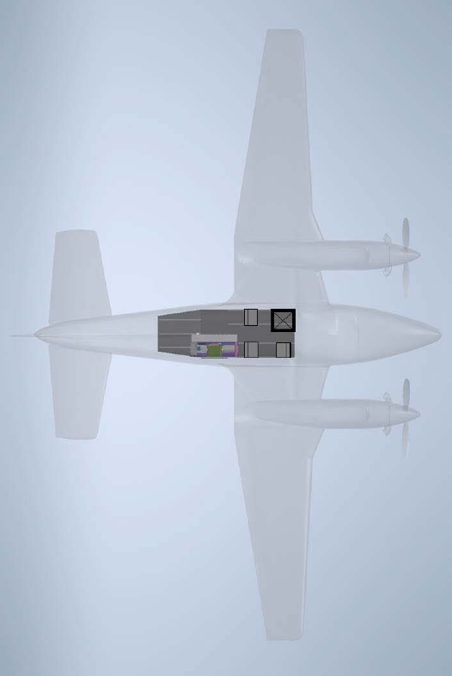
Cabin Layout
Exit door
Window exit
Fire
extinguisher
Instrument
operator
Monitor
rack
Captain
Aft
Foreword
G-LiHT
Instrument
operator
Aux. seat
(aft facing)
First Officer
Emergency window exit

Slide 26
8) Payload combination
N/A

Slide 27
9) Status of Reviews and Required Documents
Documents in blue will be updated prior to flights
NASA airworthiness statement was issued on TBD based on Final Airworthiness Review (FAR) provided to NASA’s Eastern Region Airworthiness Review Board (ER-ARB) on 16 June 2022.
Submitted Contract Aircraft Questionnaire, including:
Copy of current Airworthiness Certificate (both sides) with limitations
Copy of log book page containing entry of total aircraft time
Most recent weight and balance form
Aircraft manufacturer’s weight and balance envelope graph/chart
Copy of last aircraft inspection, with last completed and next due date
Forward, aft, right and left side looking pictures of the aircraft
Pictures of the experimenter port/protrusion to be used (internal and external)
Pictures of each type of instrument rack to be used
Pictures of proposed experimenter installation installed in aircraft
Copy of log book entry of last altimeter and static pressure system inspection
All 8110-3, 337, STC or aircraft modification documentation, used for experimenter/instrument purposes
Floor plan layout depicting the location of experiment installations inside and outside the aircraft (this includes rack and operator seats). This drawing can be CAD or hand drawn.
Proof of an electrical load analysis showing the aircraft can support the experiment installation power requirements
Proof of an electro-magnetic interference check performed with avionics and experiment installations turned on (email confirmation is acceptable)
Proof of compliance with FAA Airworthiness Directives
Copy of pilots/operators licenses, medical certification, currency and training records
Copy of Flight Test Plan (if applicable)

Slide 28
9) Status of Reviews and Required Documents (Cont’d)
Additional documents submitted:
NASA SOFRS Flight Request (FR_22M033)
Contract Aircraft & UAS Experimenter Questionnaire
GSFC Request for Non-Ionizing Radiation Safety Committee Action Laser Radiation Source Questionnaire (GSFC 23-28L)
QNC Documents (Bruce Cook, Lawrence Corp, Allison Nussbaum, Jesse Barber)
Disclosure Statement for Crewmembers and Qualified Non-Crewmembers Flying on Board Government Aircraft Operated as Public Aircraft (Form 830-AOF-0111)
NASA GSFC Aircraft Operations Mandatory Aircraft Flight Safety Brief (Form 830-AOF-0122)
Supervisor permission to fly in support of the mission
JSC Medical Certification Determination
Satern “Qualified Non-Crewmember Training” certificate (course SMA-HQ-WBT-225)
NASA GSFC Medical Surveillance Clearance High-Risk Aviation Certification (B. Cook)
NASA GSFC Hearing test submitted to NASA Hearing Conservation Program (B. Cook)
NEPA Record of Environmental Consideration (REC)

Slide 29
10) Special Weather Conditions
Data will be acquired during daylight hours, ideally within 3 hours of solar noon
Prefer cloud-free conditions, but can acquire useful science data under clouds
Can fly through precipitation events, but will not be able to collect useful science data
Data quality is reduced following precipitation events and in presence of ground fog

Slide 30
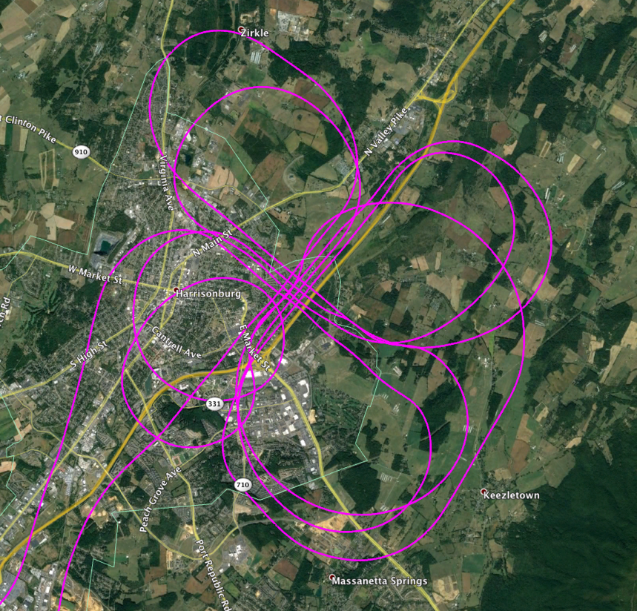
11) Instrument Check Flight Plan
Test power-up and science instruments on ground following engine start
Perform boresight pattern over urban area in Harrisonburg, VA, with pitched roofs
Evaluate data prior to deployment

Slide 31
12) Logistics Plan
I&T and a instrument check flight will take place in Bridgewater, VA, during the week of 27 June 2022.
Pilots, aircraft and G-LiHT will transit from VA to AK after instrument check flight and meet NASA instrument operators in Kodiak, AK, on 6 July 2022. There will be no stops in Canada during transit to/from AK.
NASA QNC G-LiHT Instrument Operators will fly commercial airlines to/from Kodiak, AK.
Approximately 50 flight hours are committed to transit and science flight hours, beginning 7 July 2022.
Return to home base and de-integration will take place in Bridgewater, VA, after a ~21 d field campaign in AK.

Slide 32
13) Mishap Preparedness Contingency Plan
Risks/Hazard Analysis
Terrain – We will review flight plans prior to deployment, and the aircraft GPS provides terrain awareness information.
Weather – Although we will be targeting clear skies on days, we have the ability operate in complete overcast as long as we fly 500 feet below the clouds (FAA cloud clearance requirement for Class G airspace). Data collection will be discontinued if we encounter precipitation or ground fog.
Electrical – The aircraft is equipped with 150A of 28 VDC and 3000W of 115 VAC. A military grade connector will be used to connect G-LiHT to the DC circuit, and laptops for communicating with G-LiHT will be connected to the AC circuit. G-LiHT’s maximum, continuous power requirement is ~15 A.
RFI – An RFI check will be performed during I&T.
Safety Briefings to all participants
Flight plans will be reviewed prior to departure
Pilot with provide safety and egress briefing to all passengers
Flight Manifest
A manifest will be provided to Charles Juenger via text or email prior to takeoff with a list of everyone onboard, ETD, ETA, and departing and arriving airport.

Slide 33
13) Mishap Preparedness Contingency Plan (Cont’d)
Pre-Accident plan
Flight plan will be filed daily with appropriate regional Air Traffic Control (ATC)
Dial 911 in case of emergency (pilot/operator cellphones and satellite phone)
Garmin 696 can be used to provide location coordinates
Satellite beacon will be used to track aircraft
High-Altitude transit to study sites (>10k ft AMSL, only pilots and QNC with high-risk medicals)
Open camera port will be covered
Pilot’s will be equipped with oxygen and blood-level monitoring sensors
Emergency Survival Kit
Communication devices (GCI cellphone and iridium sat phone, text with InReach Mini 2)
PLB (Ocean Signal PLB1, InReach Mini 2)
Signaling devices (flare, smoke, mirror, whistle)
Survival (folding saw, knife, lighter, headlamp, water purifier, paracord, mosquito spray, duct tape)
Orienteering device (compass)
Tarp shelter and personal bivy
First aid/trauma kit
Water and snacks
Overwater operations (as necessary)
Aircraft will be equipped with survival equipment (FAA approved life raft; US Coast Guard approved constant-wear life vest; personal location beacon; Emergency Locator Transmitter (ELT); signal flare; trauma and first aid kit) for overwater operations, in accordance with 14 CFR, Part 91, Section 509.

Slide 34
13) Mishap Preparedness Contingency Plan (Cont’d)
Mishap numbers and 24-Hr Emergency Numbers
NASA
757-894-2223 • Ops monitor
757-990-0083 • Alan Barringer, ASO
757-694-8741 • Brian Bernth, WFF Aircraft Office Chief
757-894-8140 • John Baycura, Deputy ASO
757-854-8172 • Charles Juenger
Dynamic Aviation
TBD • Ops monitor
936-522-6920 • Matt Donald, Flight Ops. Mgr.
936-522-6920 • Ethan Pearce, Dir. Flight Ops.

Slide 35
Backup

Slide 36
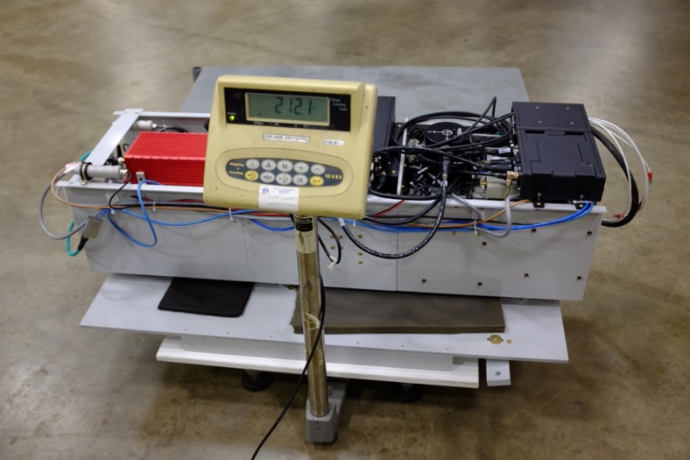
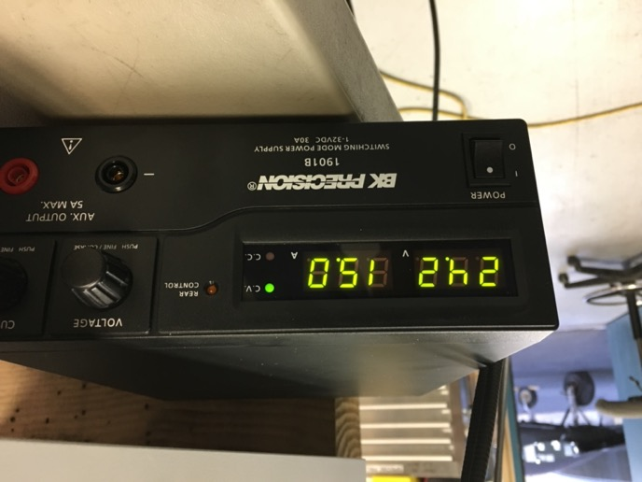
G-LiHT: Weight and Power
Total weight with interface plate = 212 lbs
Total current draw = 15 amps @ 24 VDC

Slide 37
G-LiHT v2.6: Electrical Systems
Instrument | Weight kg | Power (Vdc) | Avg Power (W) | Current (A) Maximum | Current (A) Typical | Comments
Xenics Gobi Thermal Imager | 0.5 | 12 ± 10% | 4.5 | 0.5 | 0.5 | RJ45 CAT5
Master Clock NTP100 | 0.3 | 9 to 28 | 7.5 | 1.5 | .75 | RJ45 CAT5
SWIR HSI | 4 | 12 | 15 | 1.5 | 1 | 1 x Camera Link
Spectral Evolution SR 3500 | 3.6 | 7 to 12.5 | 23 | 3 | 2 | USB 2.0
PC Controller (x2) | 5 | 12 | 100 ea | 13 ea | 8.5 ea
Total 12 V Power |  | 12 | 256 | 32 | 21.75
VFK400W 12 V Supply | 1.2 | 10 to 36 | 400 max | 33.3 | 65% | DC to DC Converter
Applanix GPS/IMU | 5 | 20 to 34 | 80 | 4.5 | 3 | RJ45 CAT5
Network Switch | 2 | 9 to 60 | 24 | 2 | 1 | RJ45 CAT5
VNIR HSI | 2 | 24 | 10 | 0.75 | .5 | 2 x Camera Link
Riegl VQ-480i LiDAR (x2) | 11.5 | 18 to 32 | 65 ea | 5 ea | 3 ea | RJ45 CAT5
Phase One IXM1000-R (x2) | 1.7 | 12 to 30 | 10 | 0.5 | 0.5 | USB 3.0
Total 24 V Power |  | 24 | 240 | 17 | 11.5
VFK400W 24 V Supply | 1.2 | 10 to 36 | 400 max | 16.7 | 69% | DC to DC Converter
Total System Components + Hardware | 56 (120 lb) 100 (220 lb) | 28 VDC | 450 W | Max Obs 18A | Typical Obs 16A

Slide 38
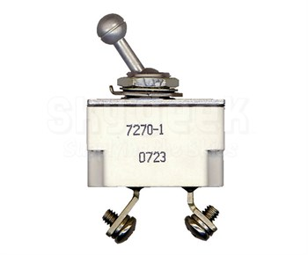
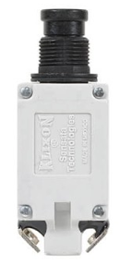
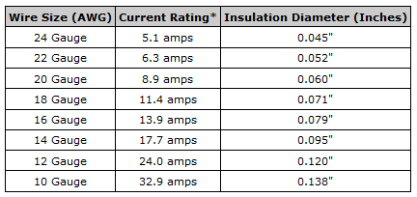
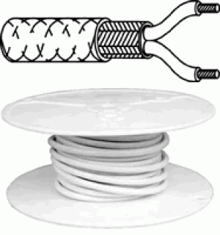
G-LiHT v2.6: Power Supply Components
2- KLIXON 7270-1-20 A main power circuit breakers.
2- Main Power Feed Lines 14 AWG Mil Tefzel.
One line feed & breaker each for 12V & 24V DC to DC Converters.
Voltage converters have built in overload & short circuit protection.
Appropriate 16 or 18 gauge Tefzel Wire used for individual component power.
Components protected through 8 appropriately rated Klixon 7274-2 circuit breakers.
Maximum observed total power draw – 18 A @ 28 VDC.
Component Power
Line Power x2
White Mil Shielded Tefzel Wire

Slide 39
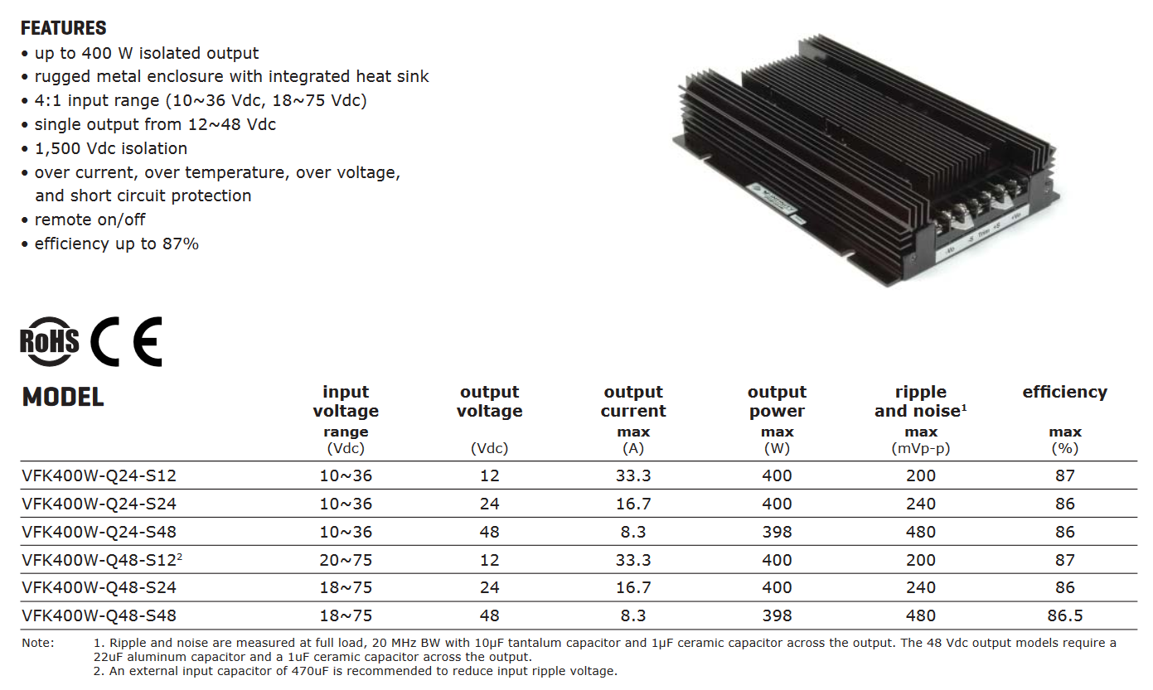
G-LiHT v2.6: Power DC to DC Converters
http://www.cui.com/product/power/dc-dc-converters/isolated/chassis-mount/vfk400w-series
http://www.digikey.com/product-detail/en/cui-inc/VFK400W-Q24-S24/102-2206-ND/2415048

Slide 40
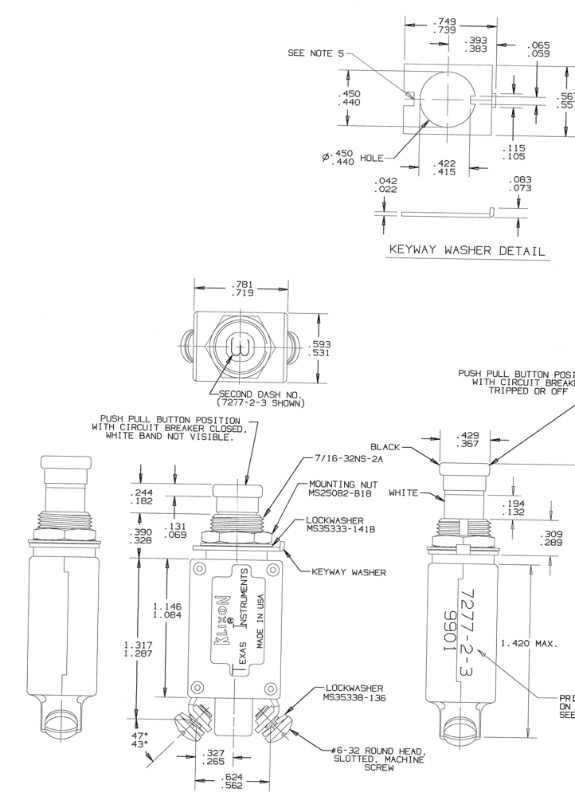
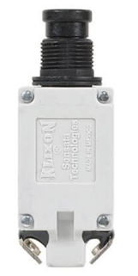
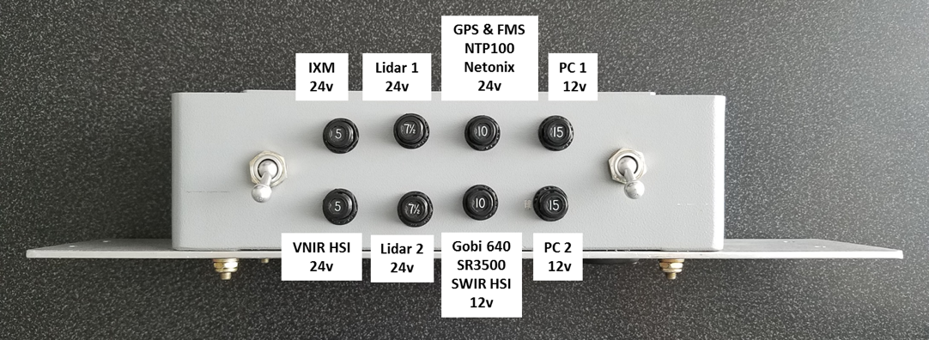
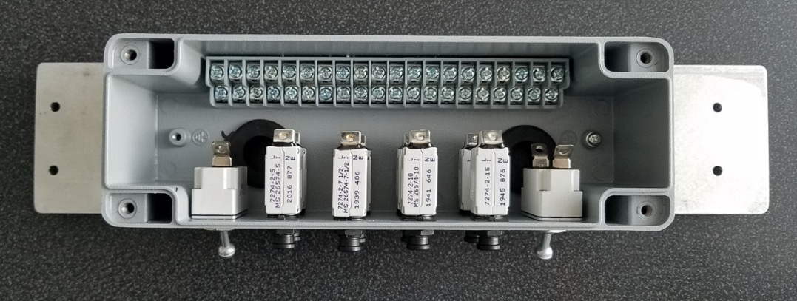
G-LiHT v2.6: Power Supply Components
8 - KLIXON 7274-2 CIRCUIT BREAKERS

Slide 41
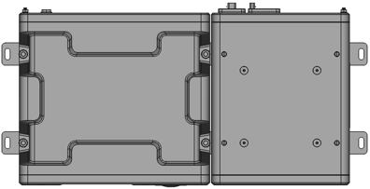
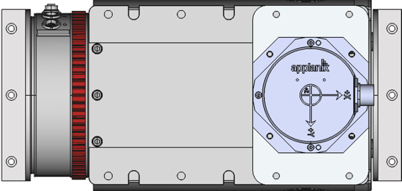
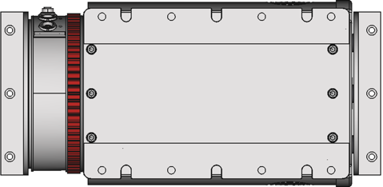
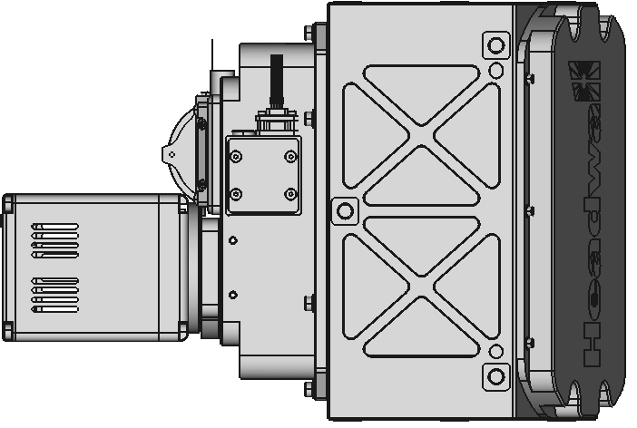
G-LiHT 2.x: Instrument Layout (top view)
LiDAR Module #1
Optical Module
LiDAR Module #2
Network Switch
b
g
c
d
e
f
LiDAR VQ 480i #1
g
a
f
Micro-Hyperspec VNIR imaging spectrometer(400-1000 nm)
SWIR imaging spectrometer (900-2500 nm)
PhaseOne IXU-R 1000 survey-grade RGB camera (100 MP)
Xenics Gobi 640 thermal camera (8-12 um)
Spectral Evolution VSWIR solar irradiance spectrometer
Applanix POS AV GPS-INS
Riegl VQ-480i lidars
Drawing Scale
200 mm

Slide 42
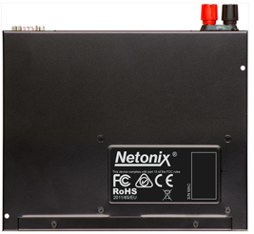
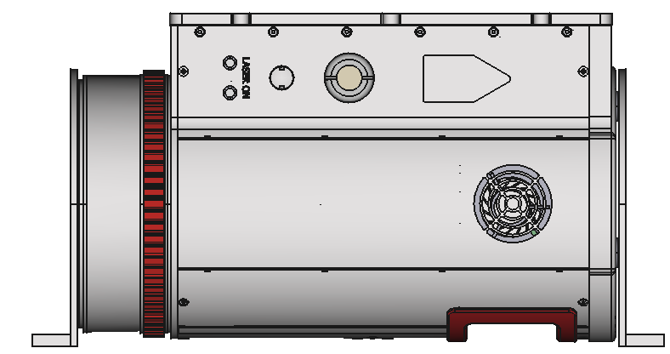
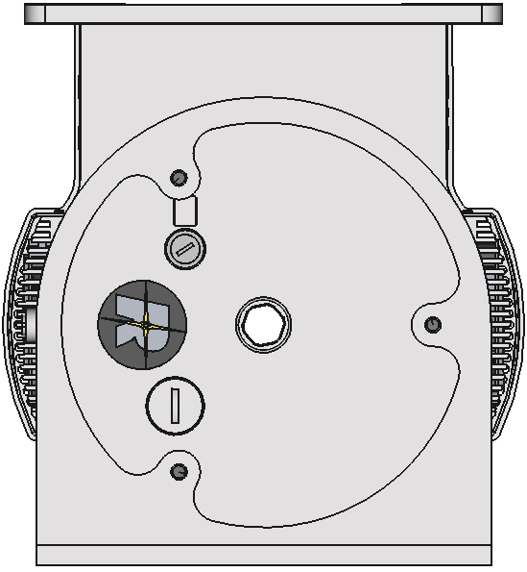
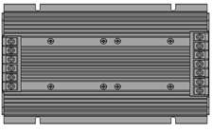
G-LiHT 2.x: Lidar Module #1
Side views:
End view:
Applanix GPS
Applanix GPS
Applanix
IMU
Ethernet hub
Masterclock
time sync
Aft
Forward
Primary lidar
VQ 480i
DC-to-DC
converter
DC-to-DC
converter
starboard side wall
Drawing Scale
200 mm

Slide 43
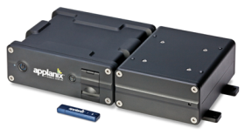
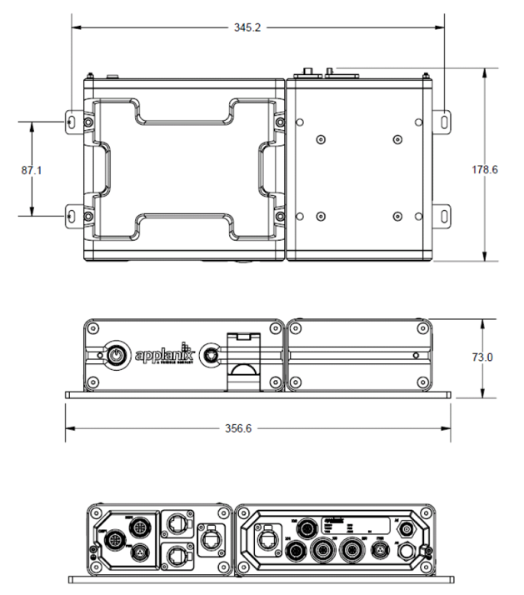
G-LiHT: GPSINS System
Model: POS AV V6
SN: 6456
HW Ver. 1.1
Amps. 4.5 max
Volts 20-34 DC

Slide 44
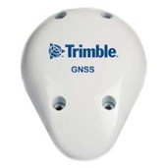
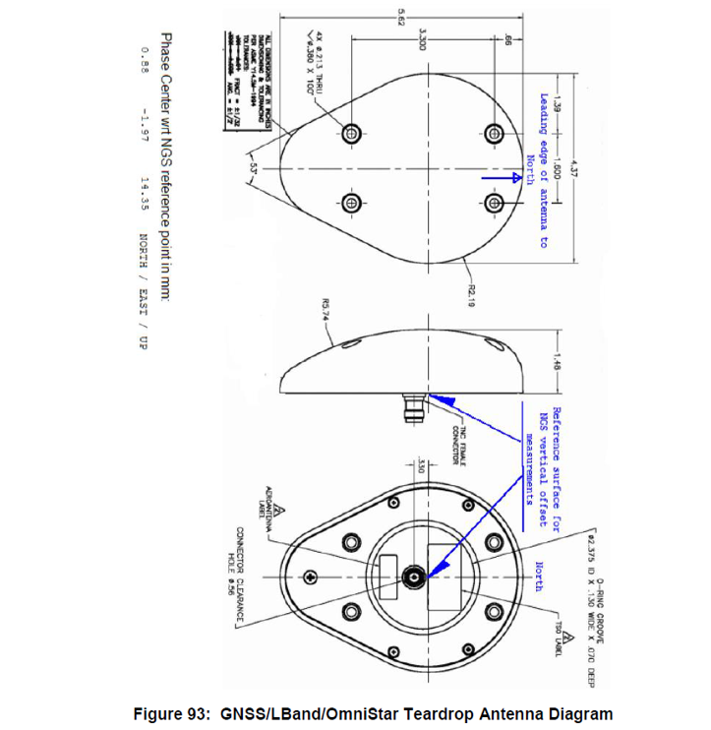
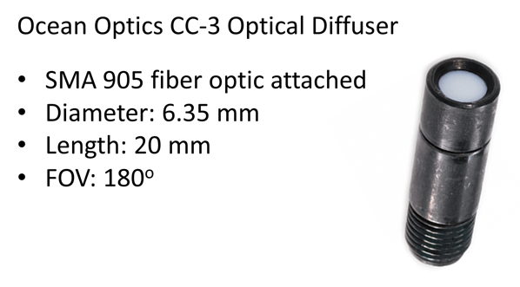
G-LiHT: Antenna Farm Components

Slide 45
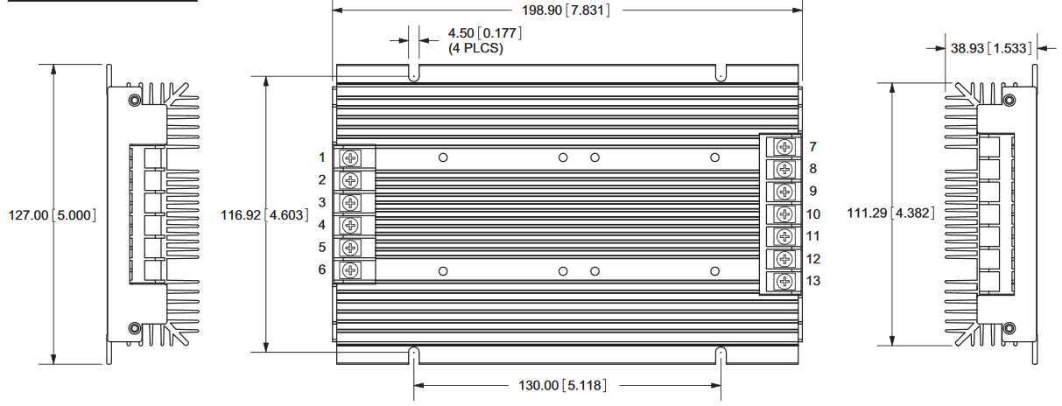
G-LiHT: DC-to-DC Power Converter

Slide 46
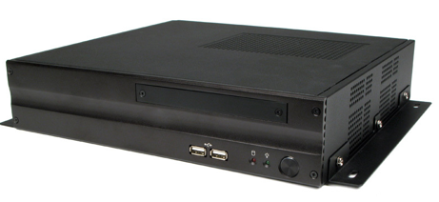
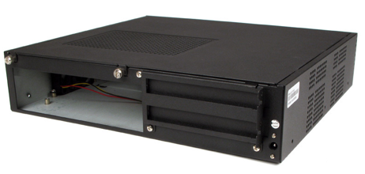
G-LiHT: PC Enclosure

Slide 47
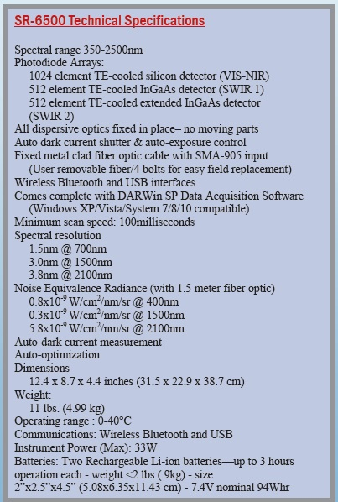
G-LiHT: VSWIR Solar Irradiance Spectrometer

Slide 48
G-LiHT: Masterclock GPS Time Server

Slide 49
G-LiHT: Ethernet Hub
Netonix WS-12-250-DC 12-Port Managed POE Switch, DC 250Watt, 9 to 60V DC variable input range

Slide 50
G-LiHT: Location of Wire Rope Isolators (bottom view)

Slide 51
G-LiHT: Wire Rope Isolators
WR4-400-10 DL (threaded helical locking)

Slide 52
G-LiHT: Instrument Operator Seats
Monitor
rack
Right
seat
Left
seat
Left seat
Monitor rack

Slide 53
G-LiHT: Monitor Rack

Slide 54
G-LiHT: GPS Used for Flight Line Following
Garmin 696

